Slide 1

CASE STUDY FOR BANK LOAN DEFAULTERS
Anushka Bajpai

Slide 2

Problem Statement
Given a consumer finance company specializes in lending loan (different types) to it’s customers.
When a customer applies for a loan, the company needs to make a decision for approval on the basis of the applicant’s profile details.
Two major considerations :
1. If the applicant ends up not repaying the loan amount (defaulter), the bank will have to bear a financial loss
2. If the applicant is likely to pay back the loans, then rejecting their application would result as a loss of business to the company

Slide 3
Steps Involved in Analysis
Data Loading
Data Inspection
Data Cleaning
Data Imputation / Outliers Analysis
Data analysis
1. Data binning
2. Univariate analysis
Categorical (ordered)
3. Bivariate and Multivariate analysis
Numeric-Numeric
Categoric-numeric
Categoric-categoric
Numerical (continuous)

Slide 4
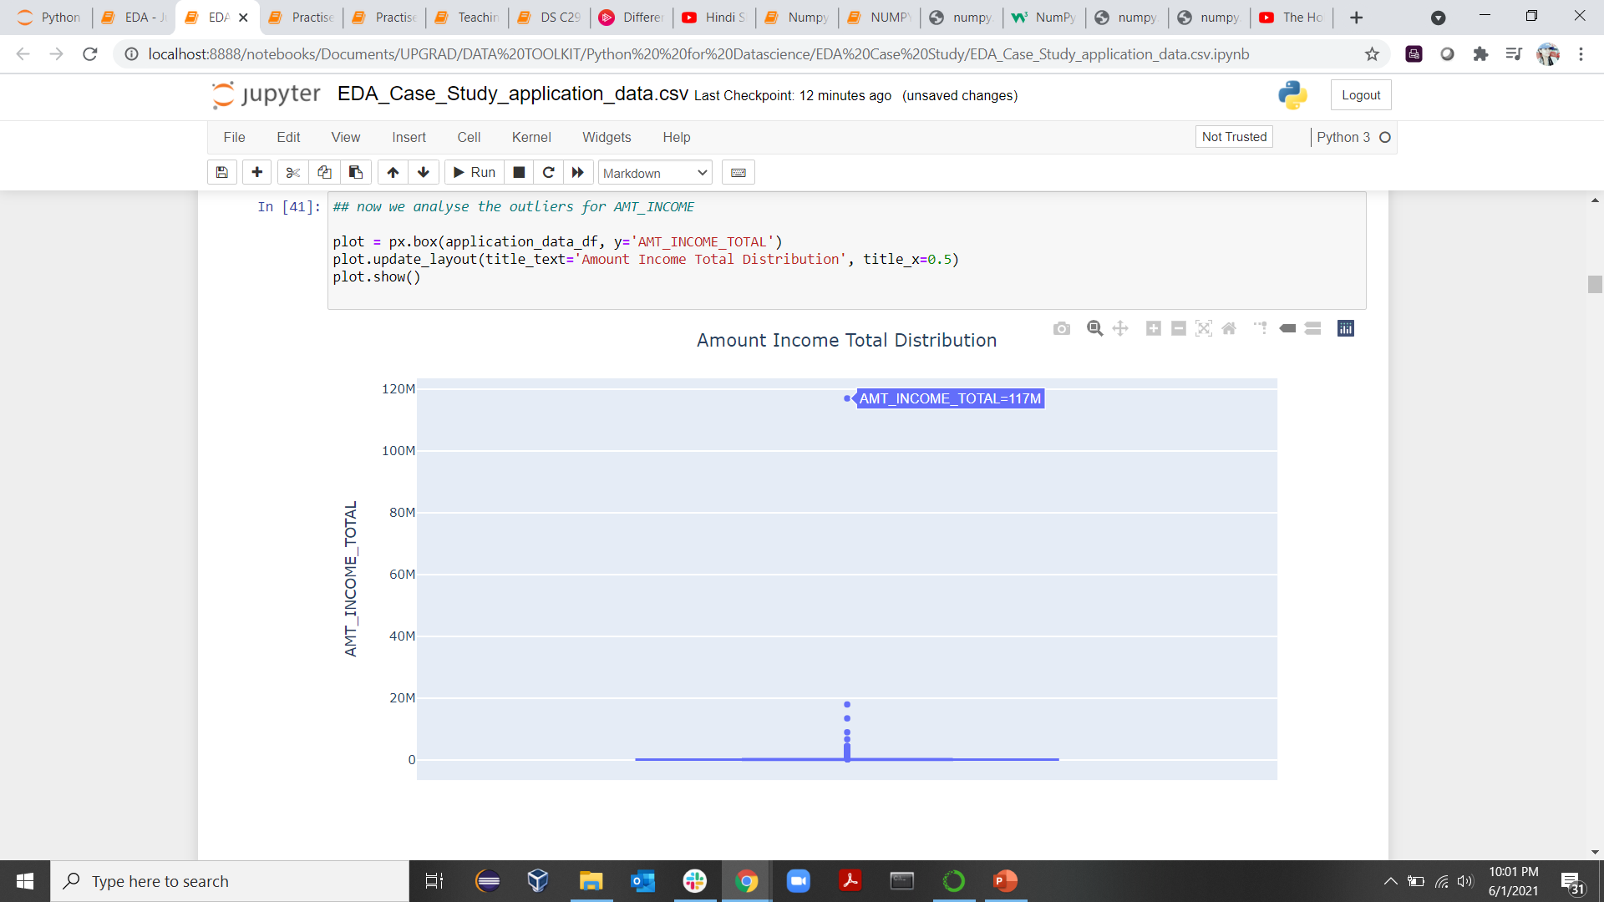
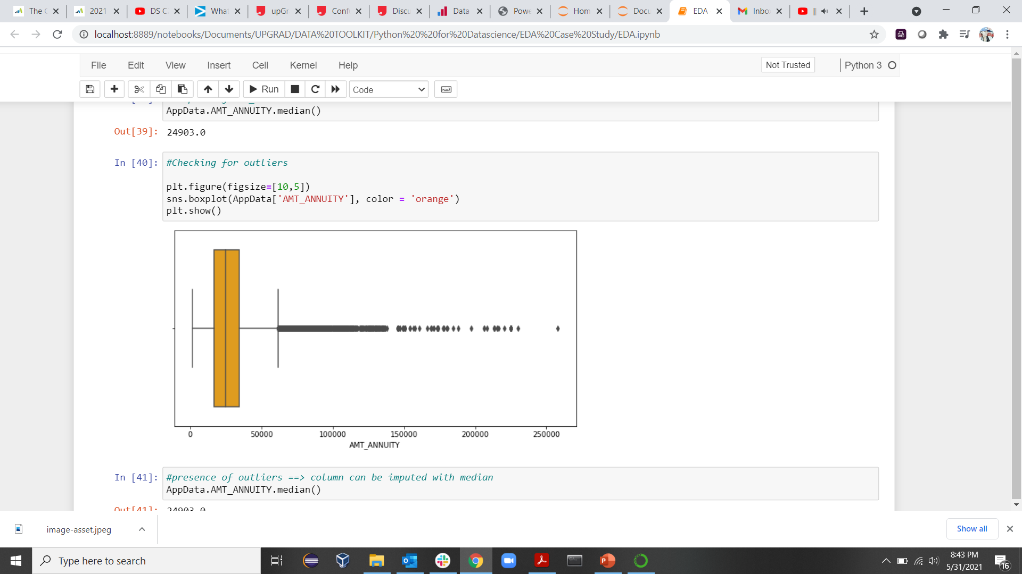
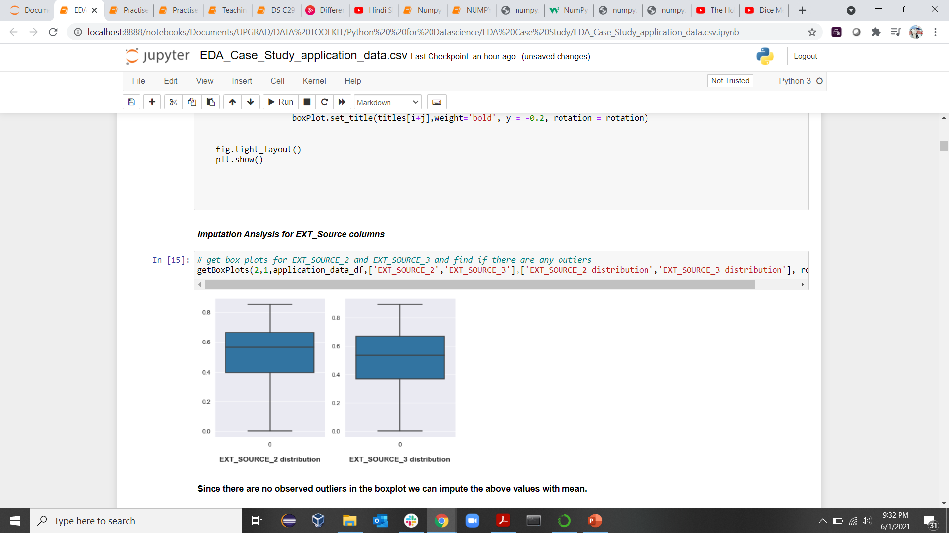
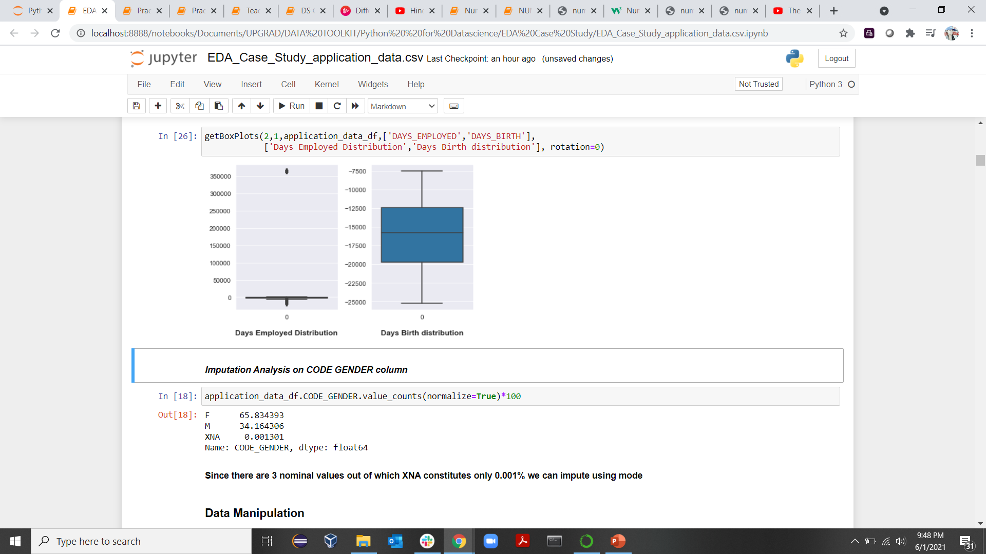
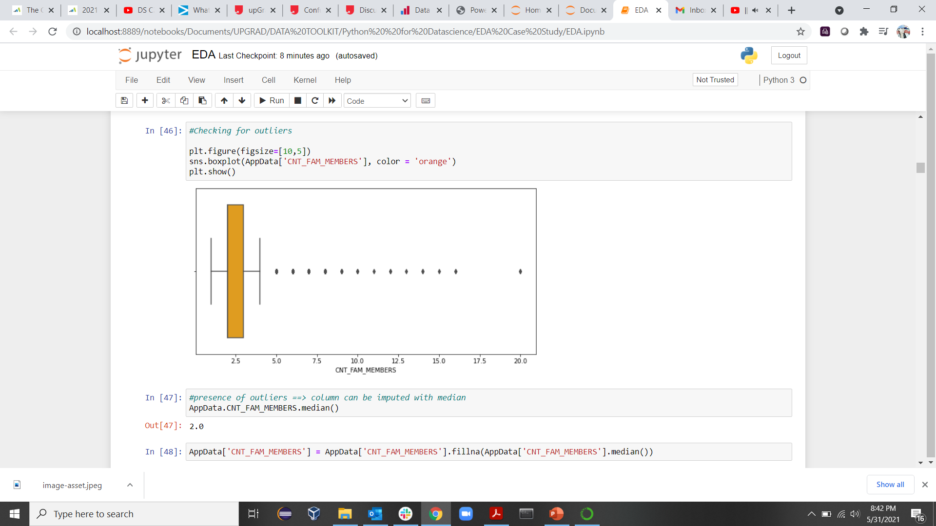
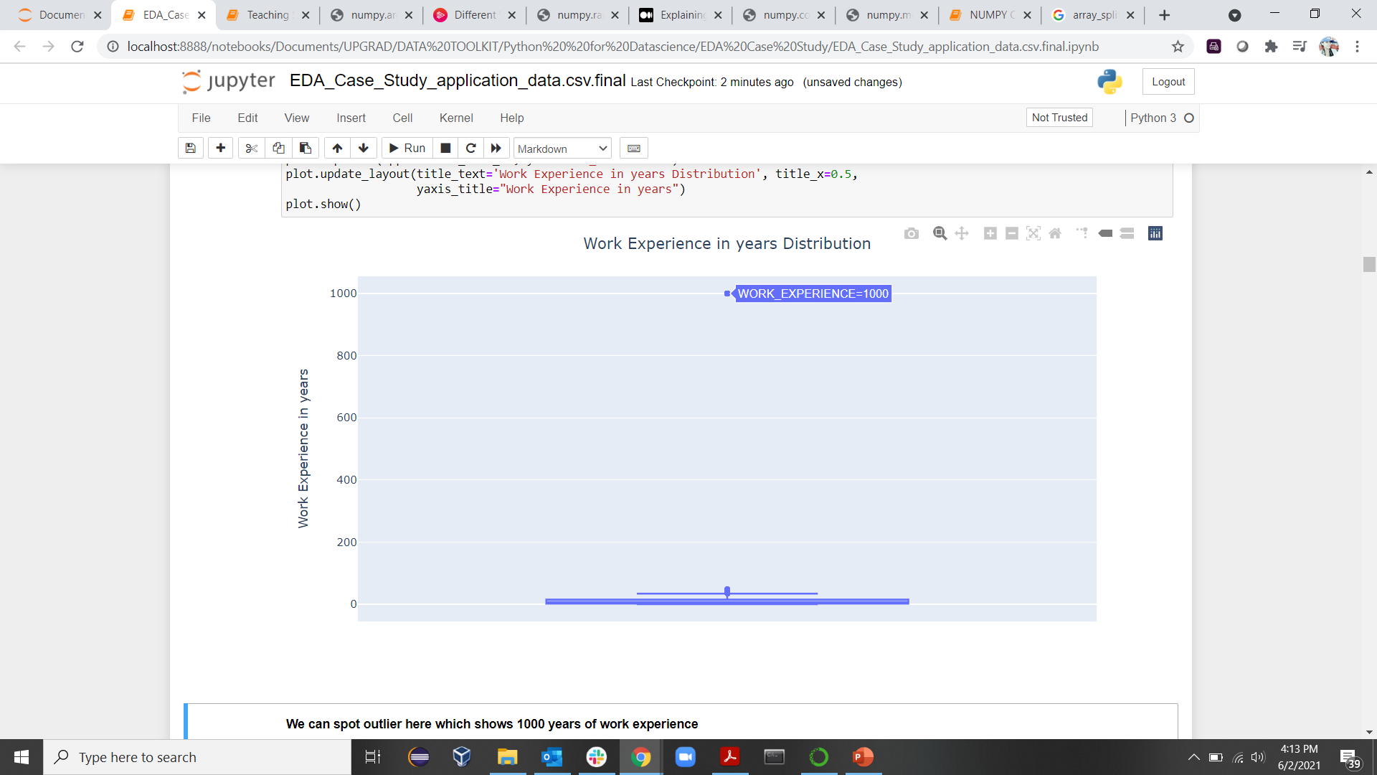
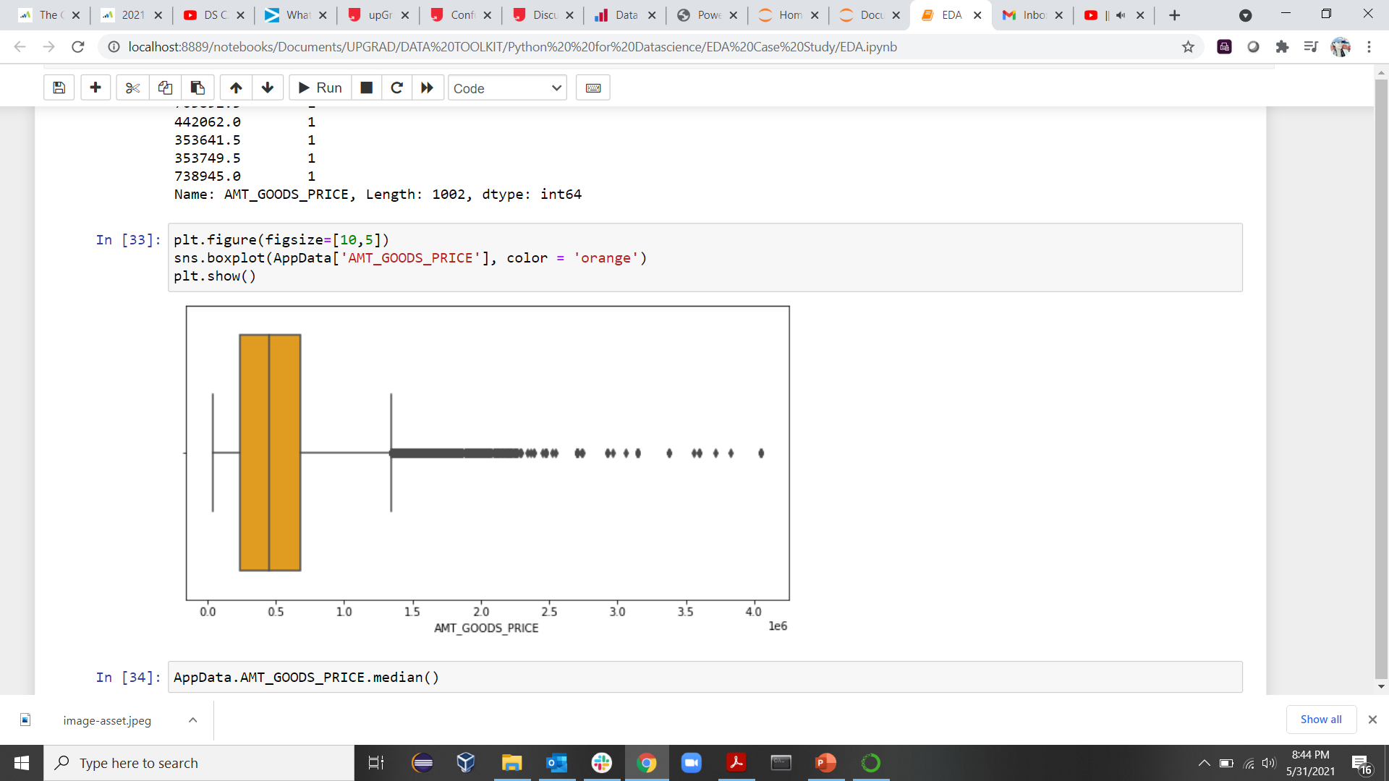
Outliers/Imputation Analysis
No Outliers observed in :
EXT_SOURCE_2
EXT_SOURCE_3
DAYS_BIRTH
No imputation needed for these as data is reliable enough. We can replace the missing values with Mean.
Outliers observed in :
CNT_FAM_MEMBERS
AMT _ANNUITY
AMT_GOODS_PRICE
AMT_INCOME_TOTAL (in millions) - 117
WORK EXPERIENCE (in years) – 1000
In case of outliers, we can impute the missing values with Median

Slide 5
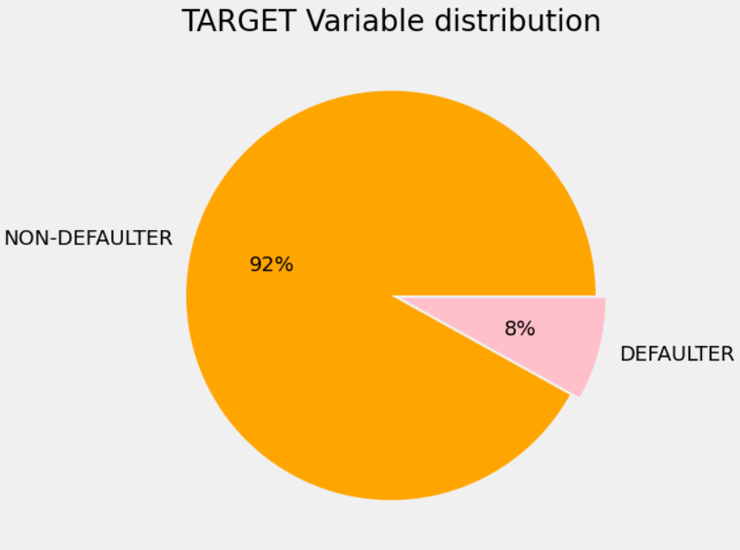
Imbalance in Data
Clear imbalance in target variable because among all the applicants, we have 92% of the Applicants who were able to pay back the loan and 8% who defaulted.
The ratio implies that there are 11 tar0 for 1 tar1 (~approx), i.e, There is 1 defaulter and 11 non-defaulters for every 12 applicants.

Slide 6

Univariate Analysis
Categorical
Continuous
Discrete
Numerical

Slide 7
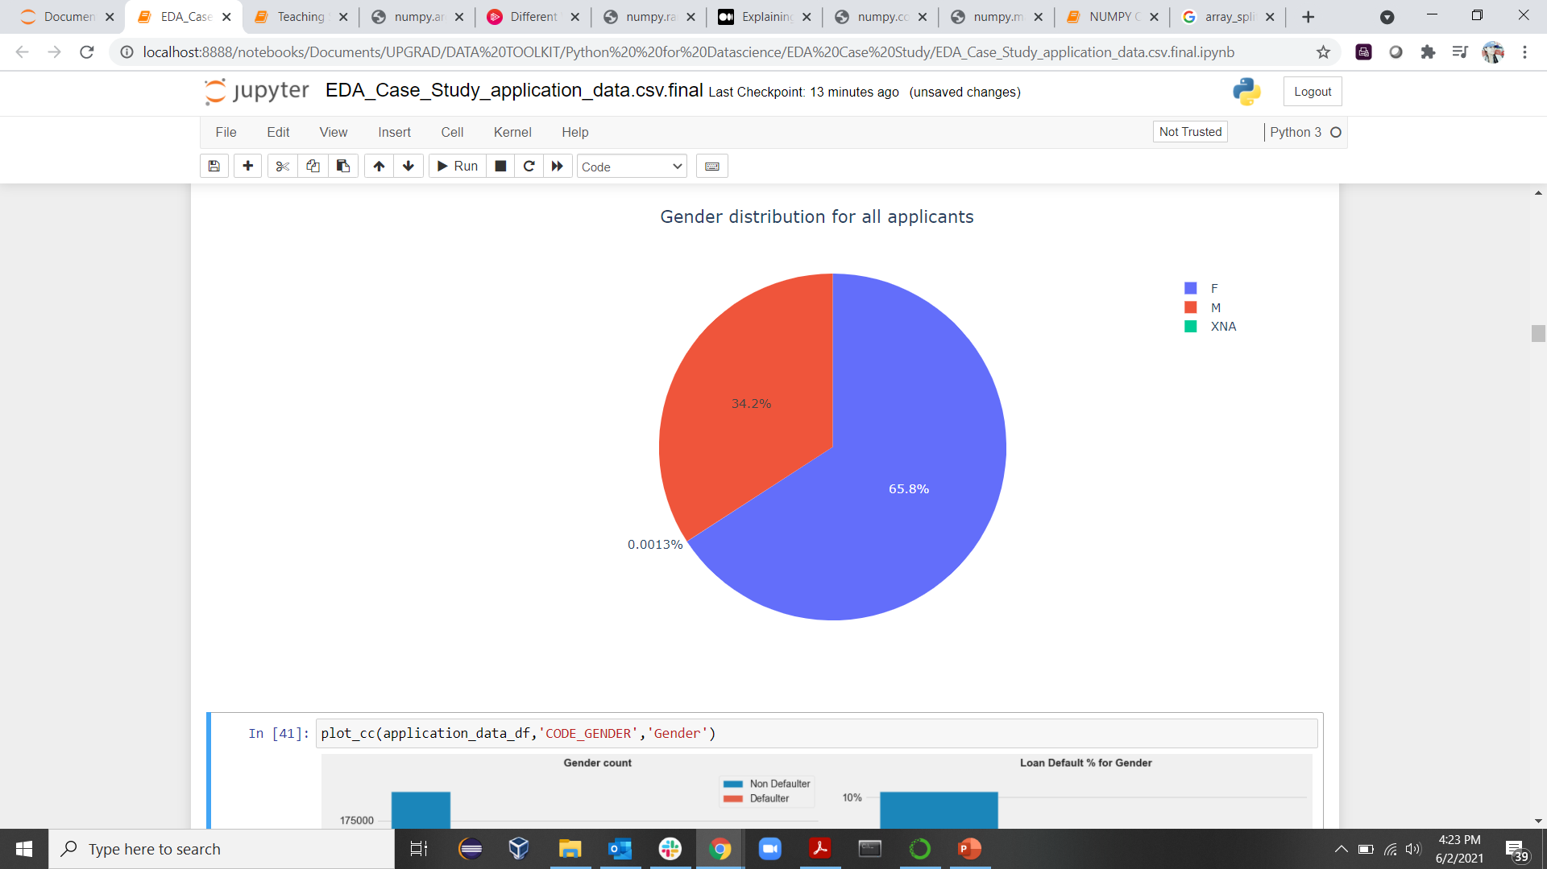
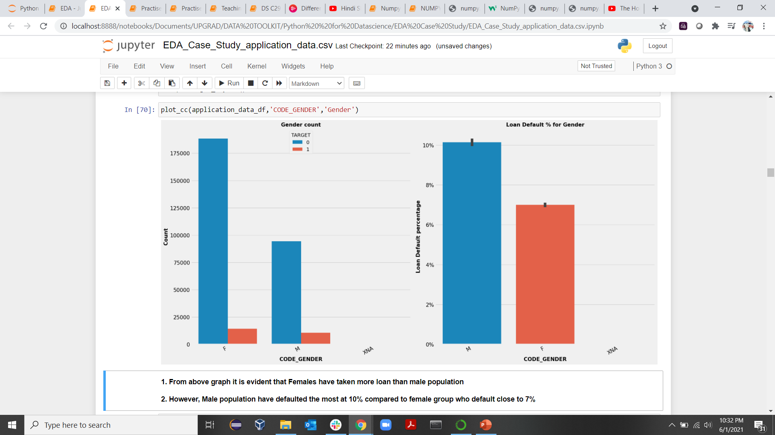
CODE_GENDER

Slide 8
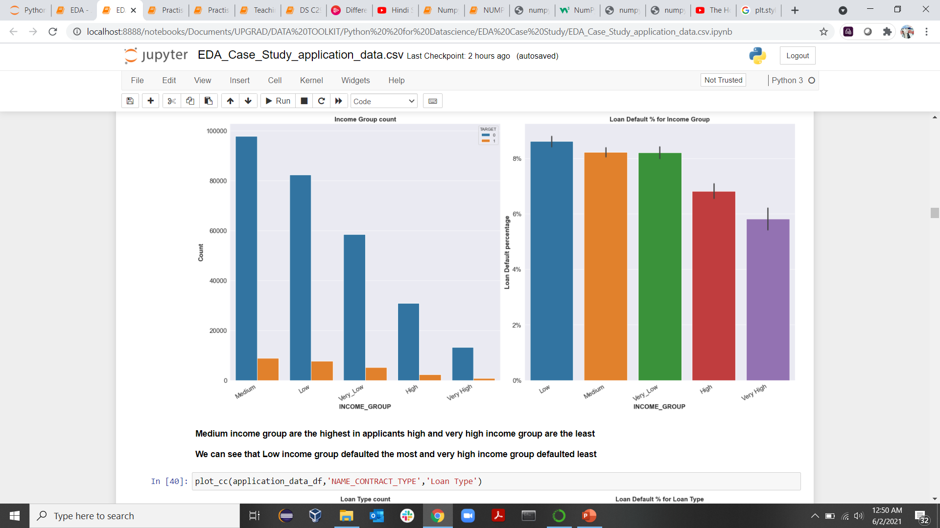
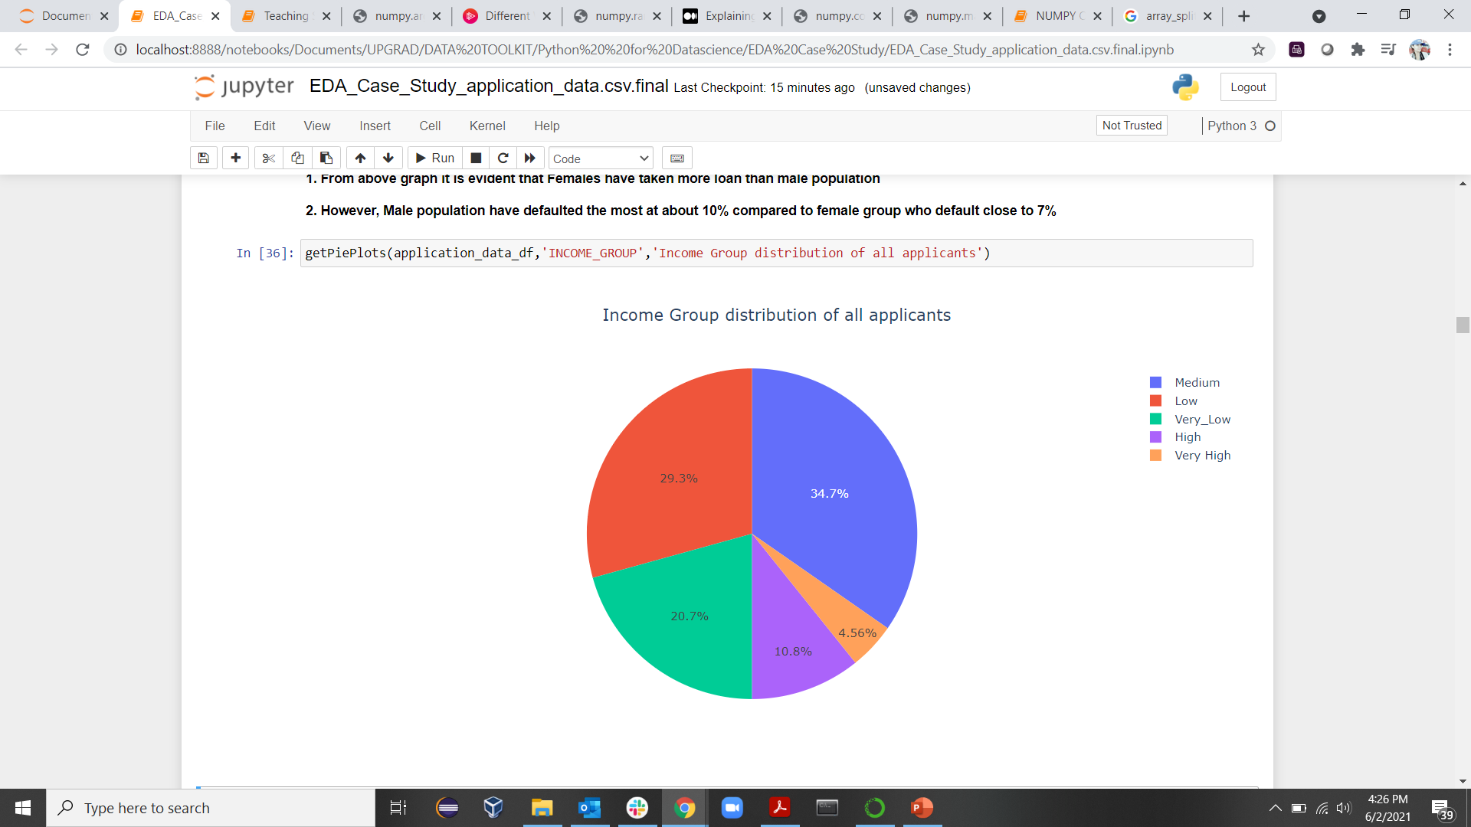
Amount Income Range

Slide 9
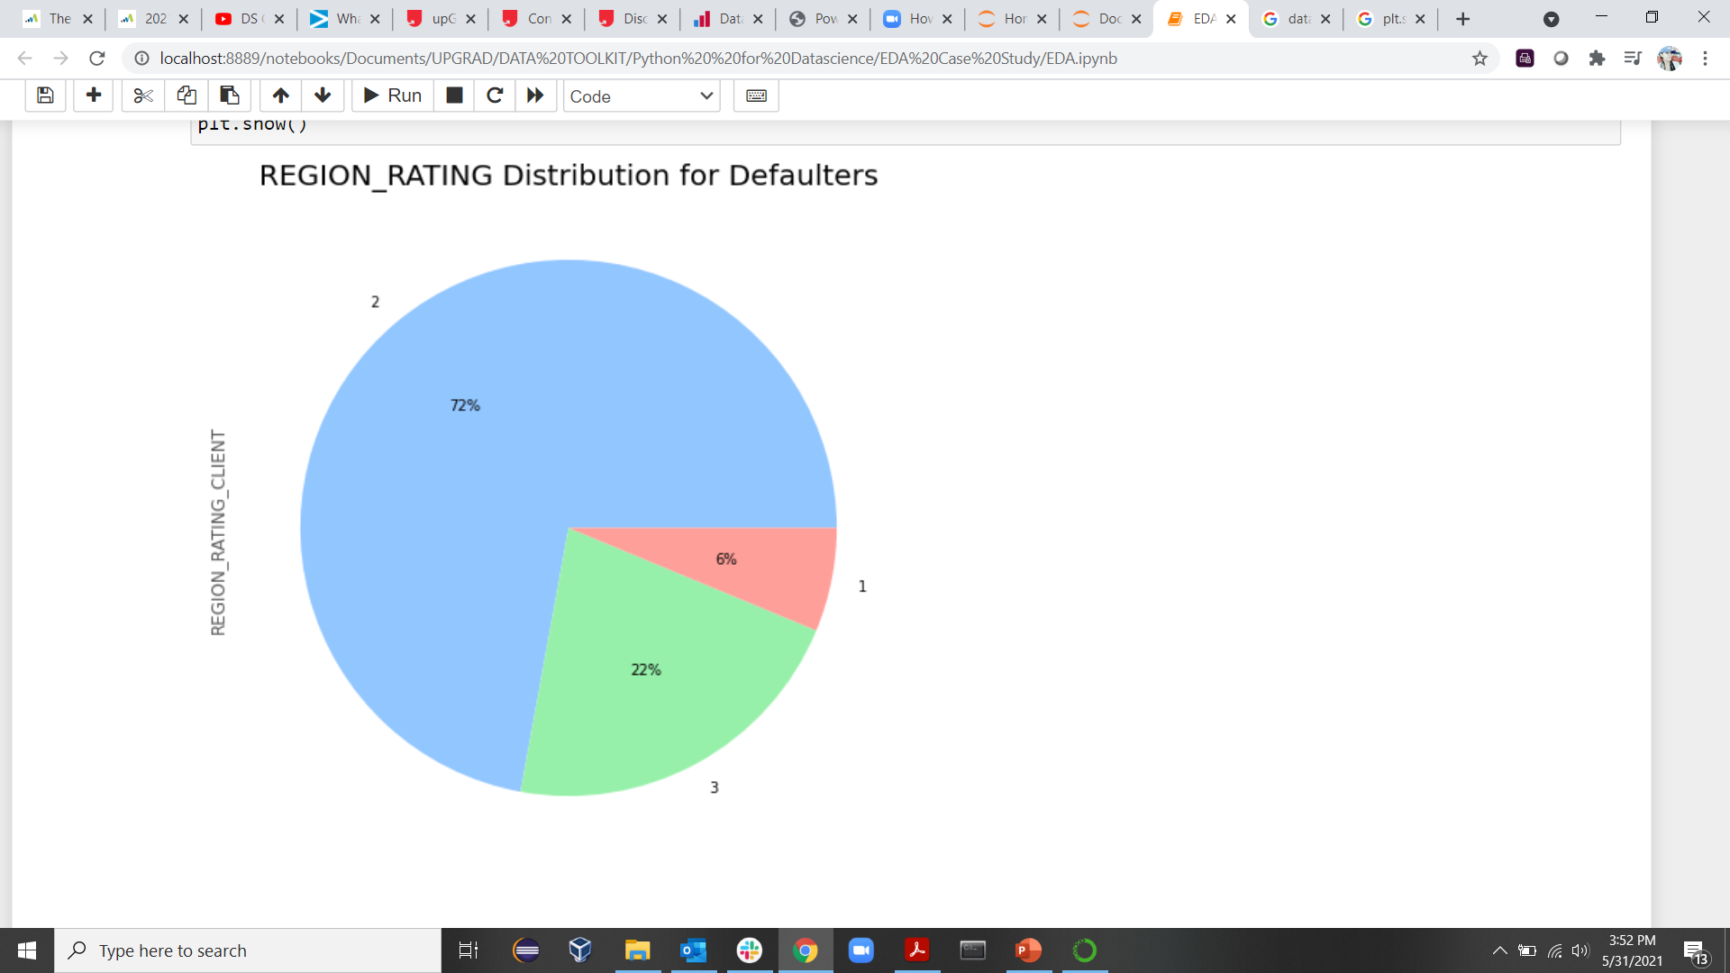
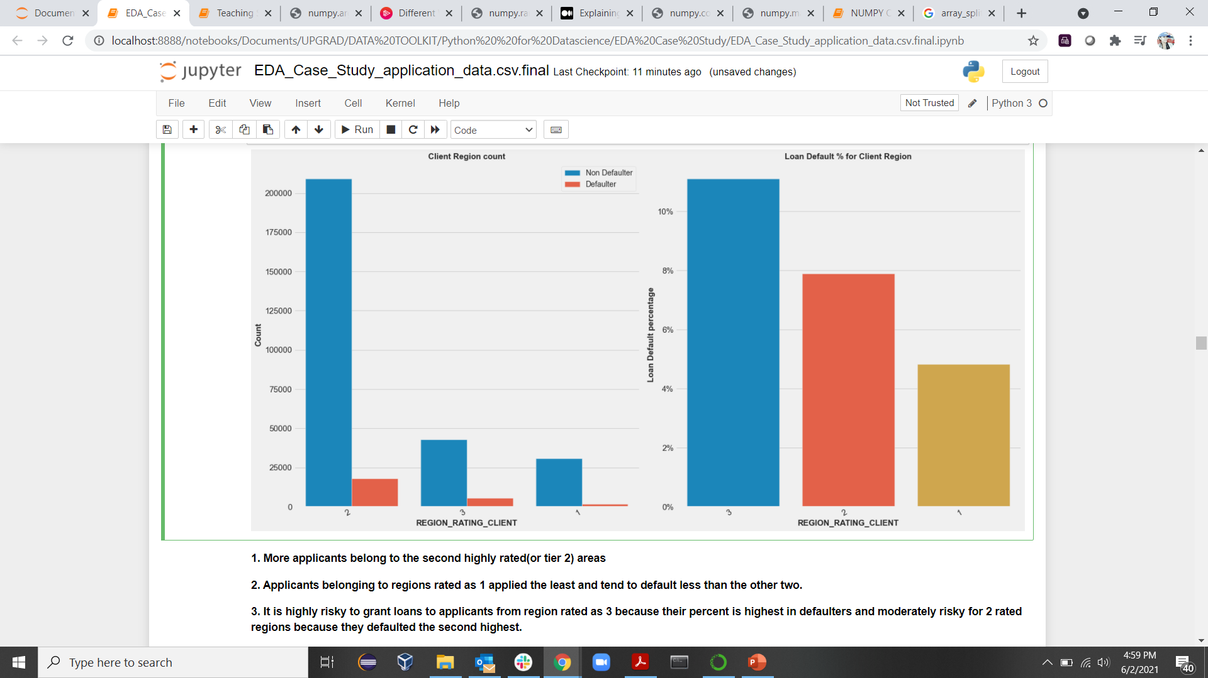
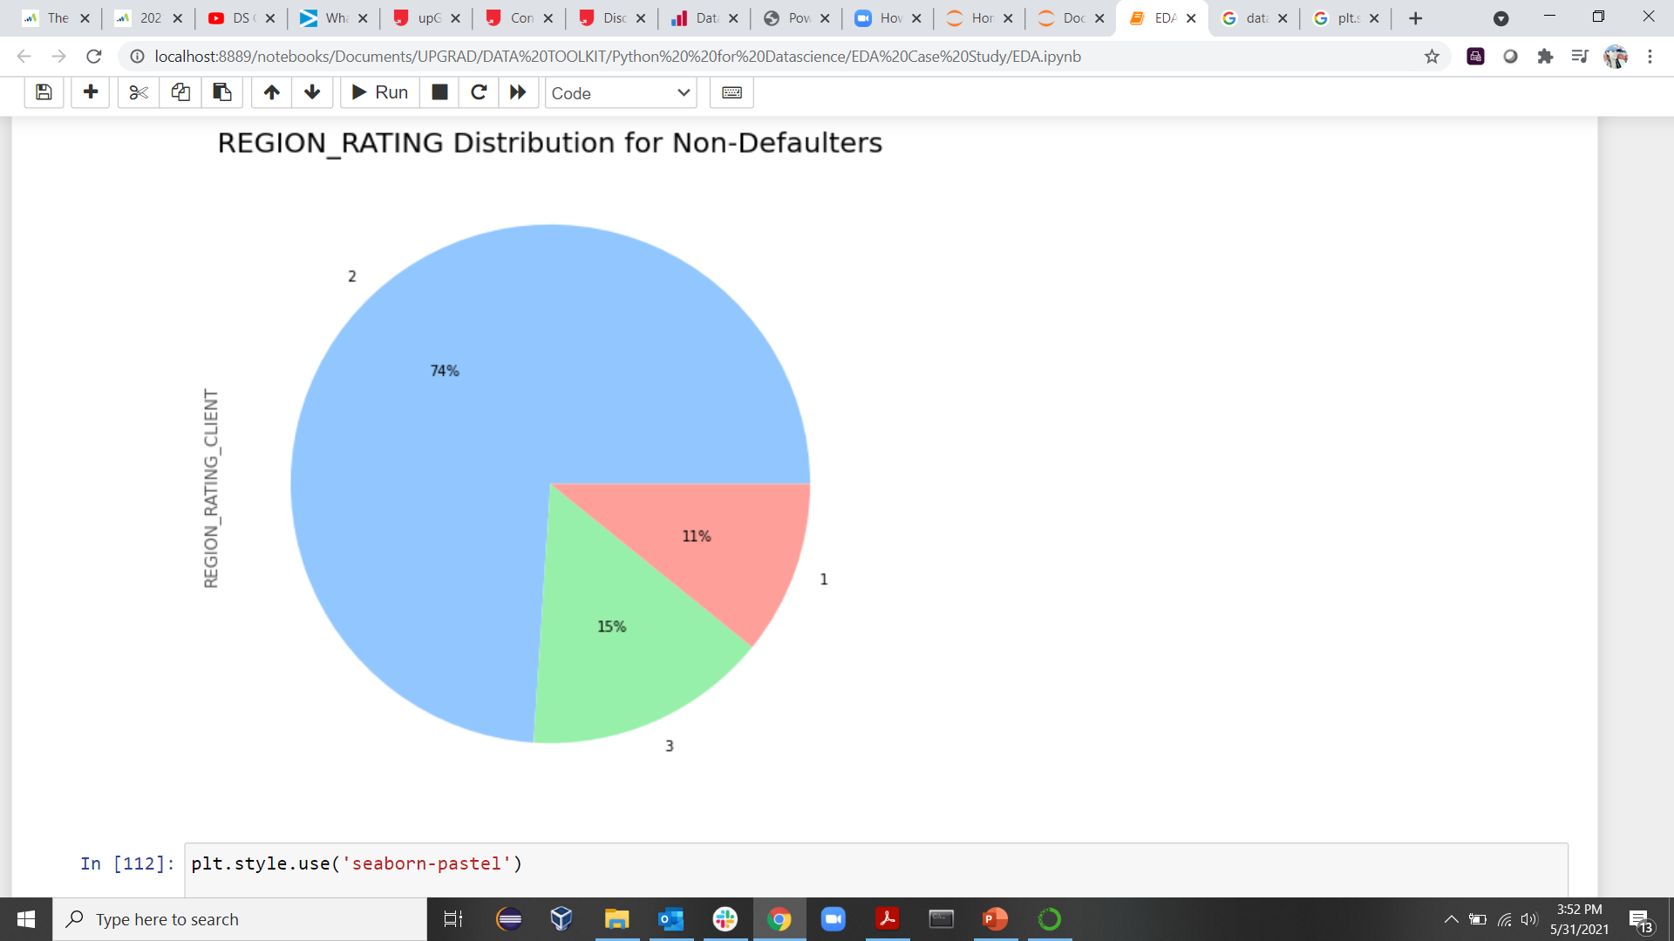
Region Rating

Slide 10
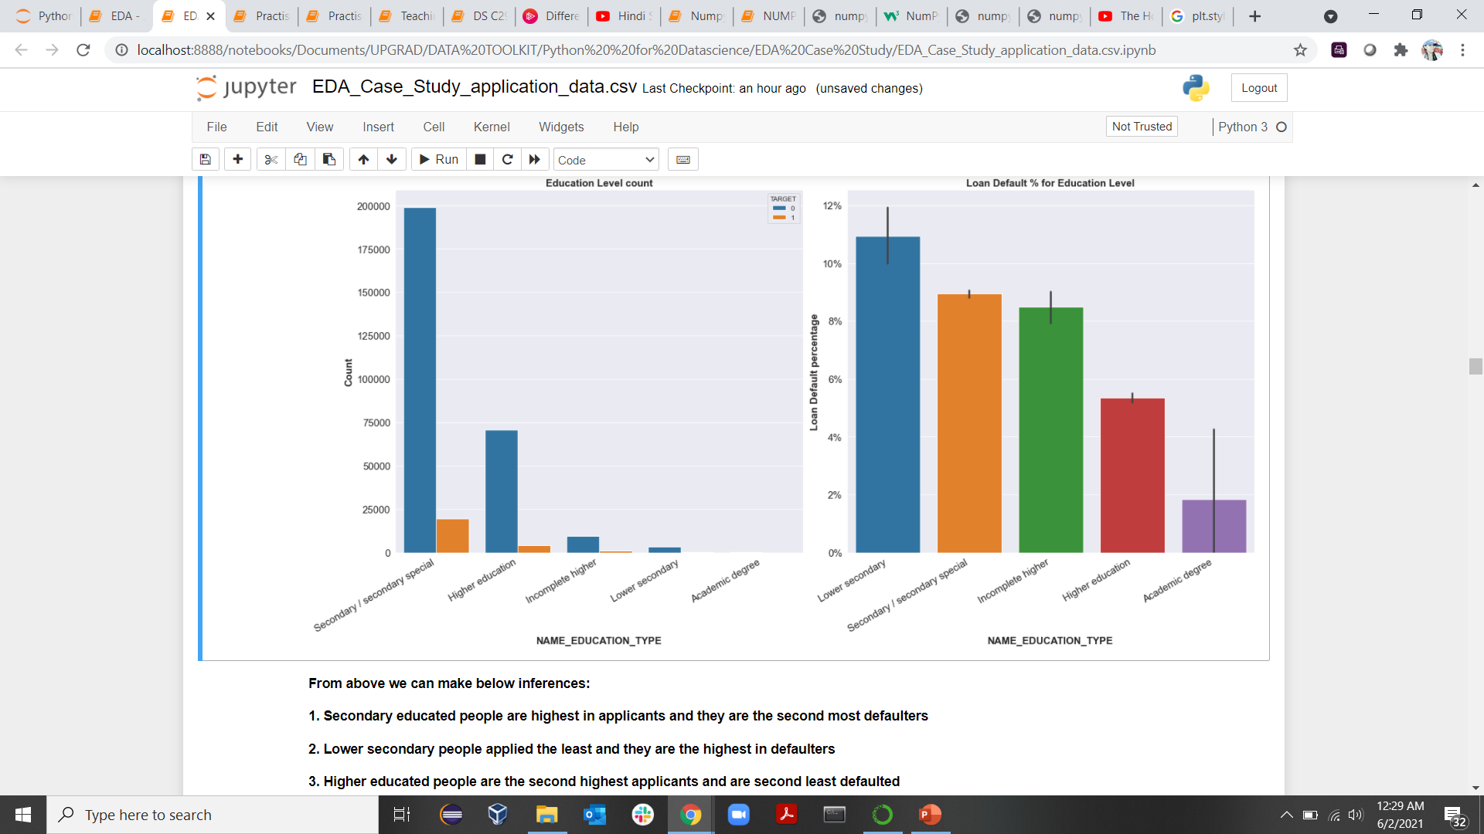
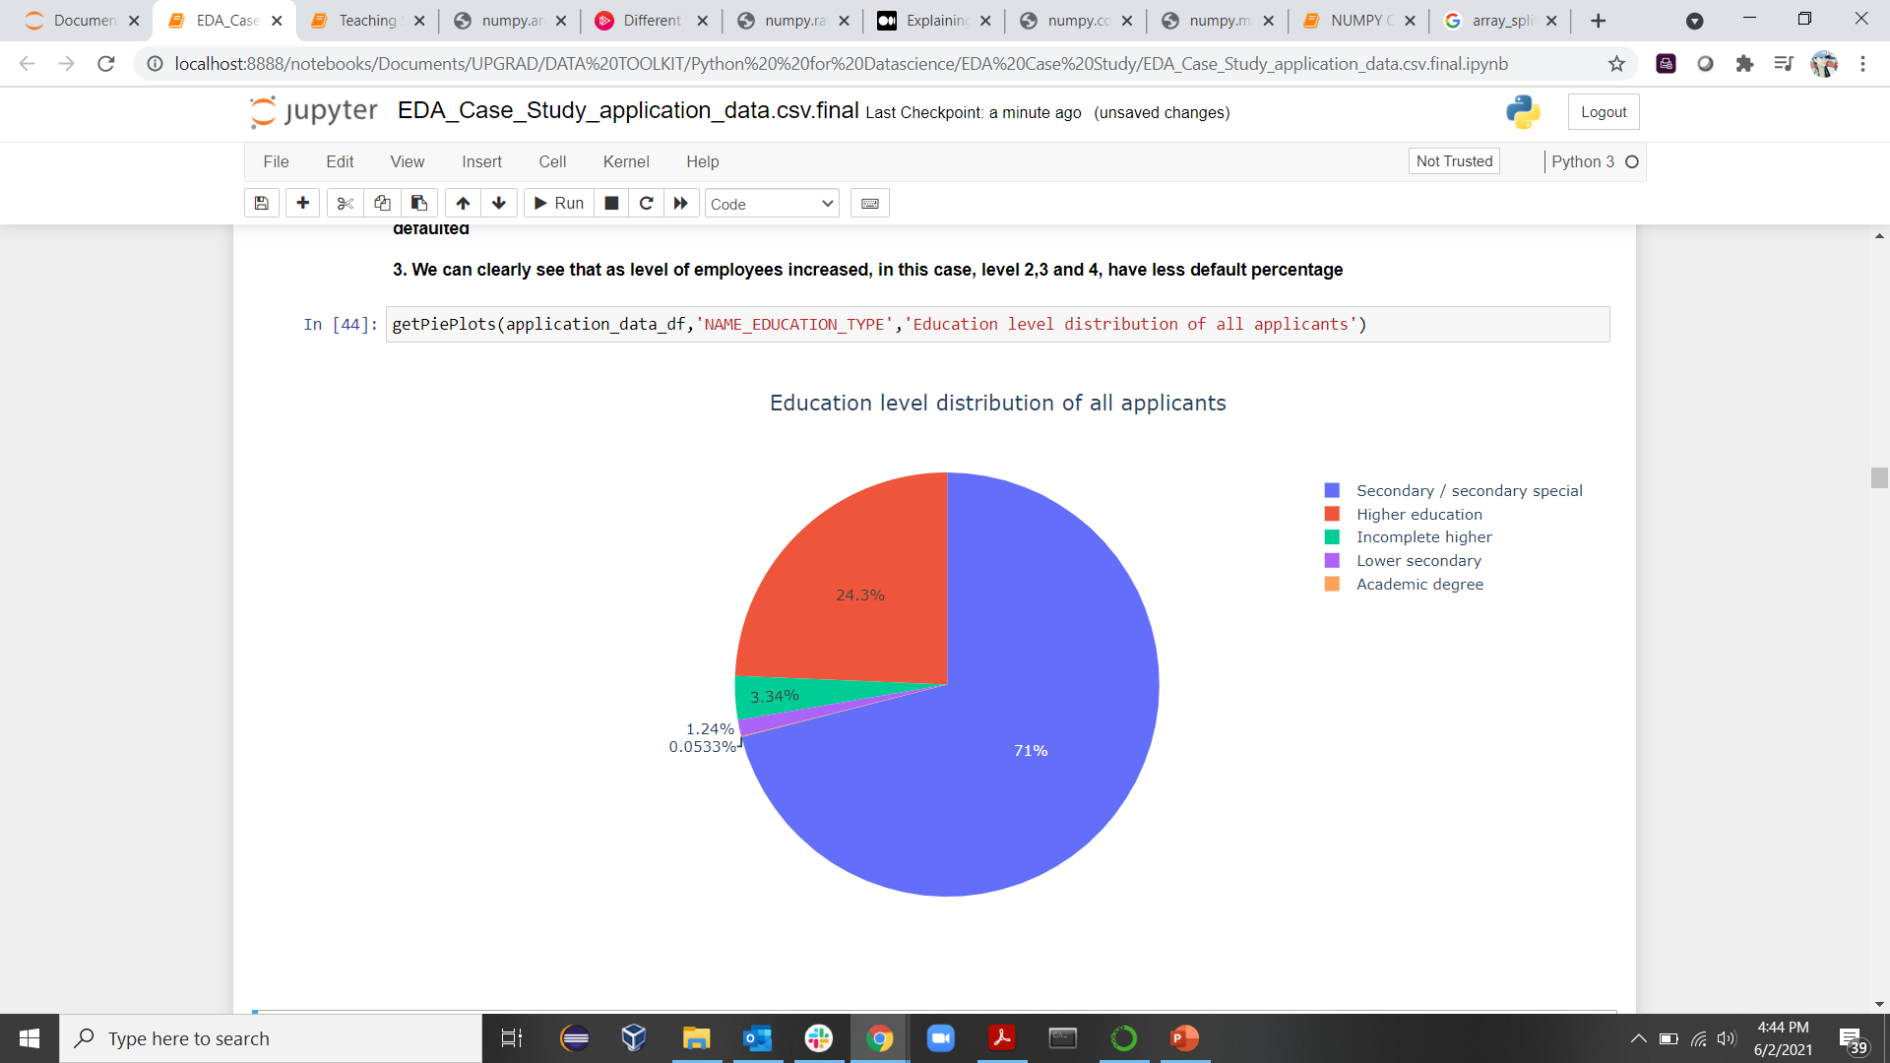
Education Type
From above we can make below inferences:
1. Secondary educated applicants are highest in applicants and they are the second most defaulters
2. Lower secondary applicants applied the least and they are the highest in defaulters
3. Higher educated applicants are the second highest applicants and are second least defaulted
4. We can also see that academic degree applicants applied least and defaulted the least
We can also conclude from right hand side graph that default percentage decreased as education level decreased

Slide 11
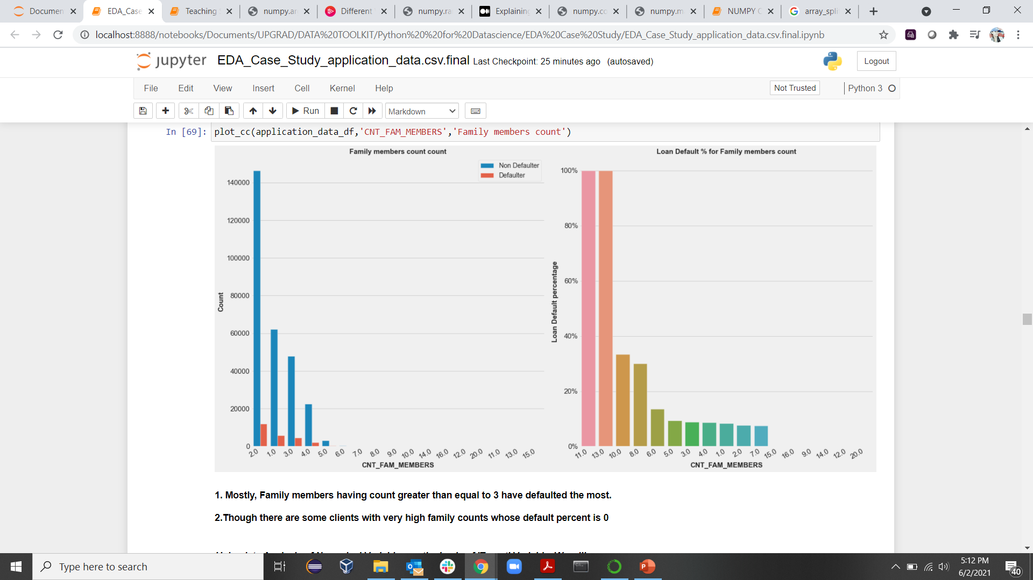
Family Members Count

Slide 12
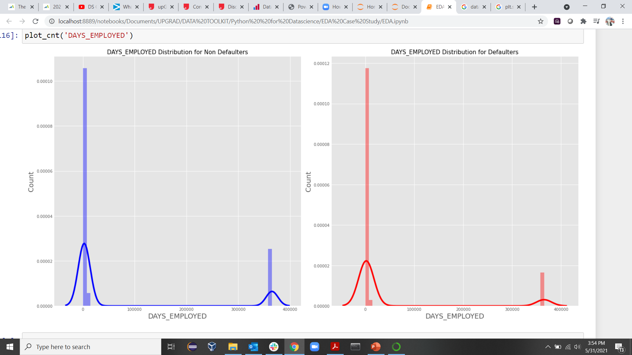
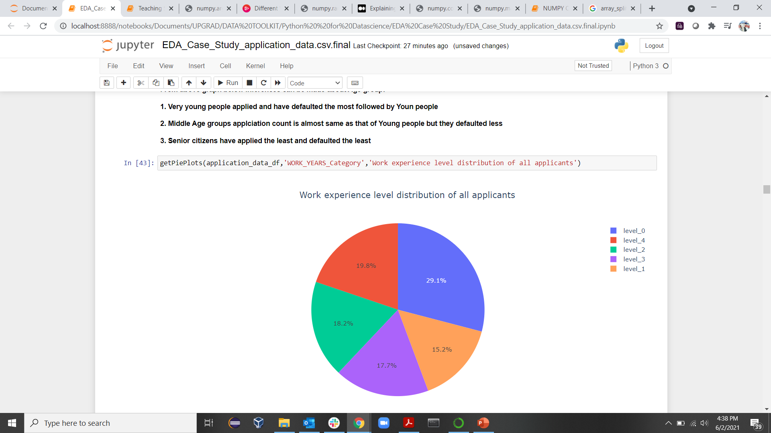
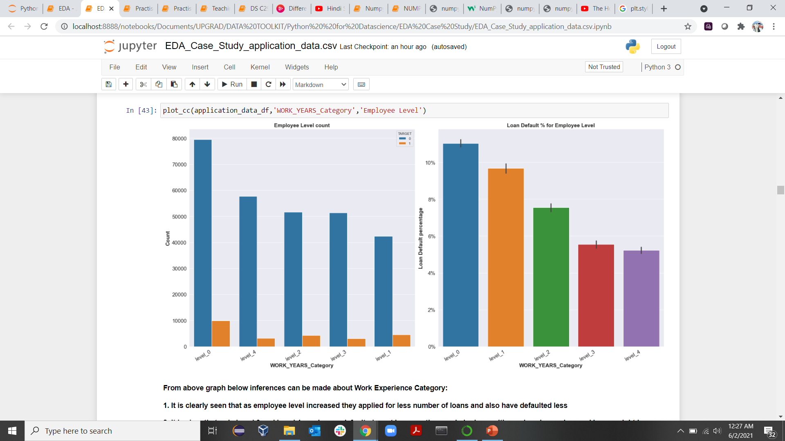
Work_Experience
1. It is clearly seen that as employee level increased, they applied for less number of loans and also have defaulted less.
2. It is clear that only Level 0 and Level 1 employees defaulted most because they are in junior positions, draw less salary and hence might have defaulted
3. We can clearly see that as level of employees increased, in this case, level 2,3 and 4, have less default percentage

Slide 13
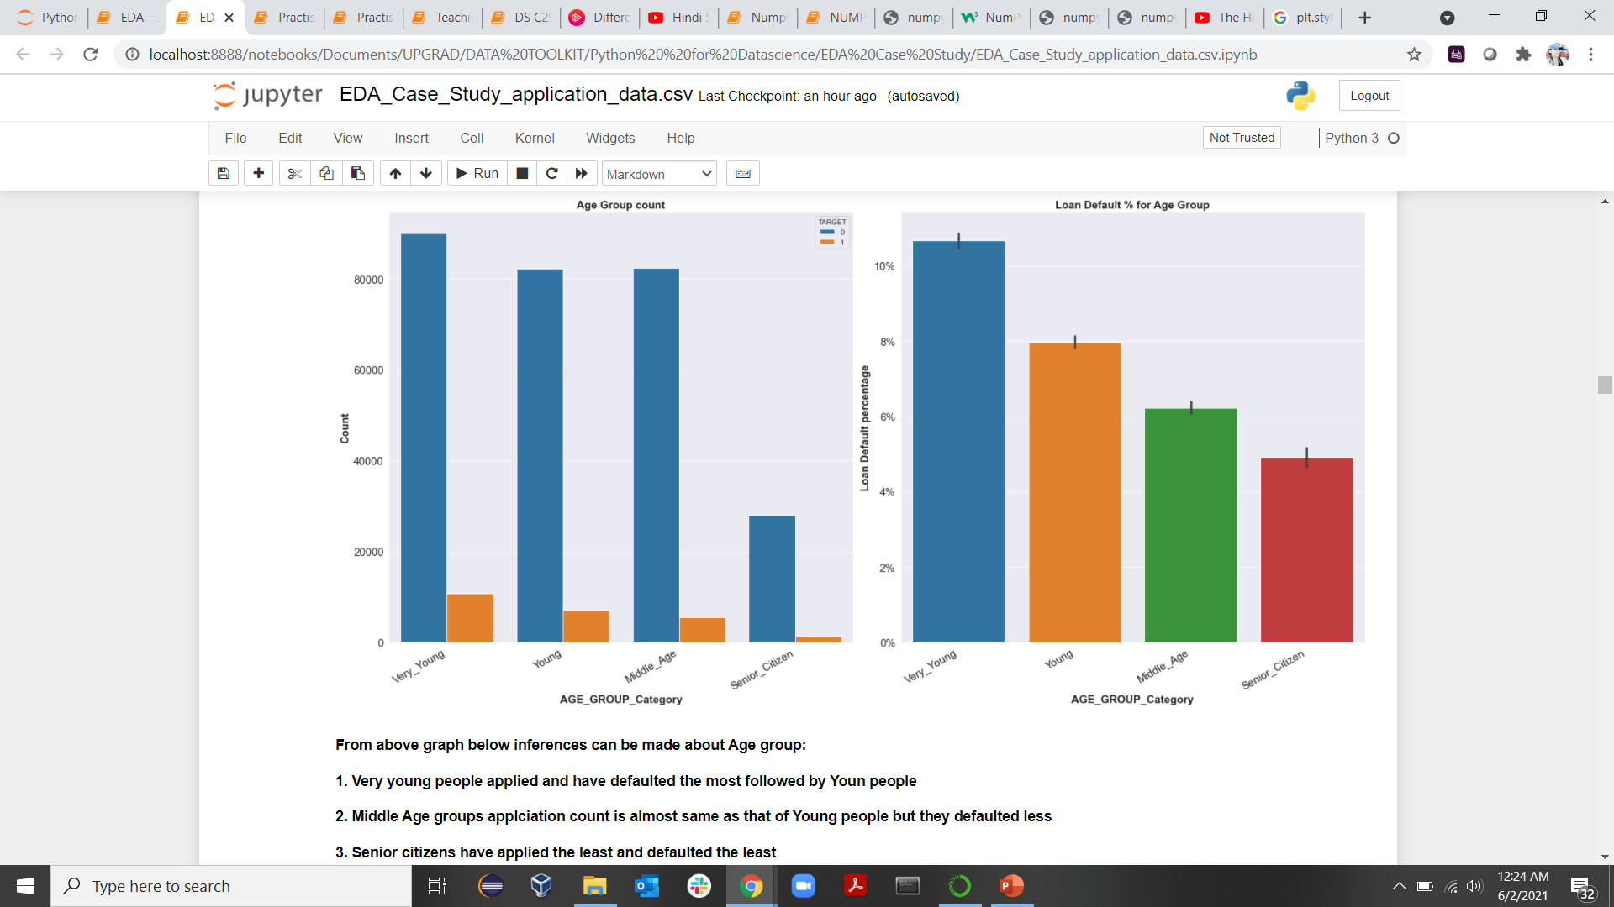
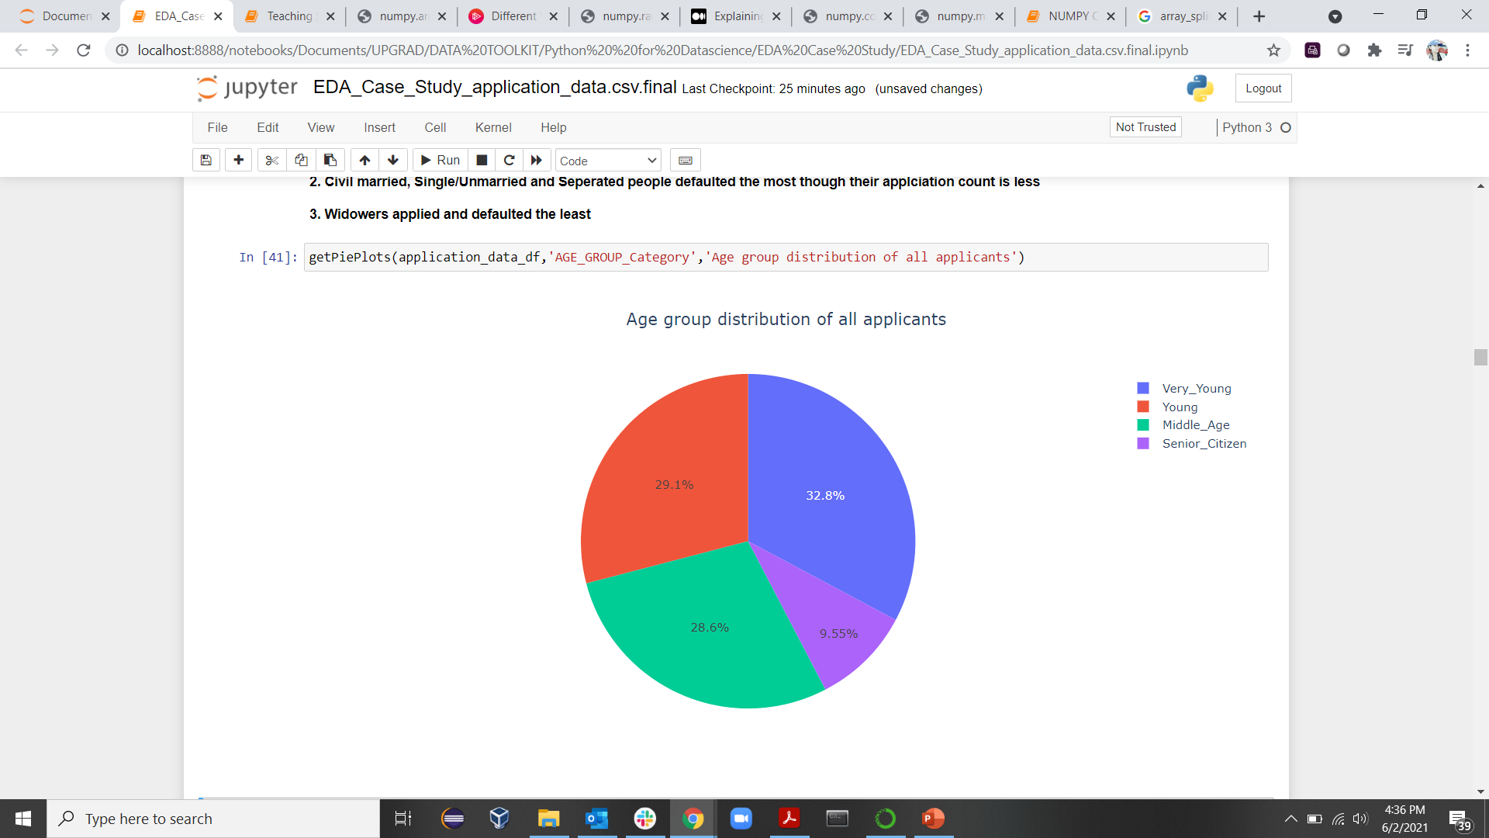
Age Groups

Slide 14
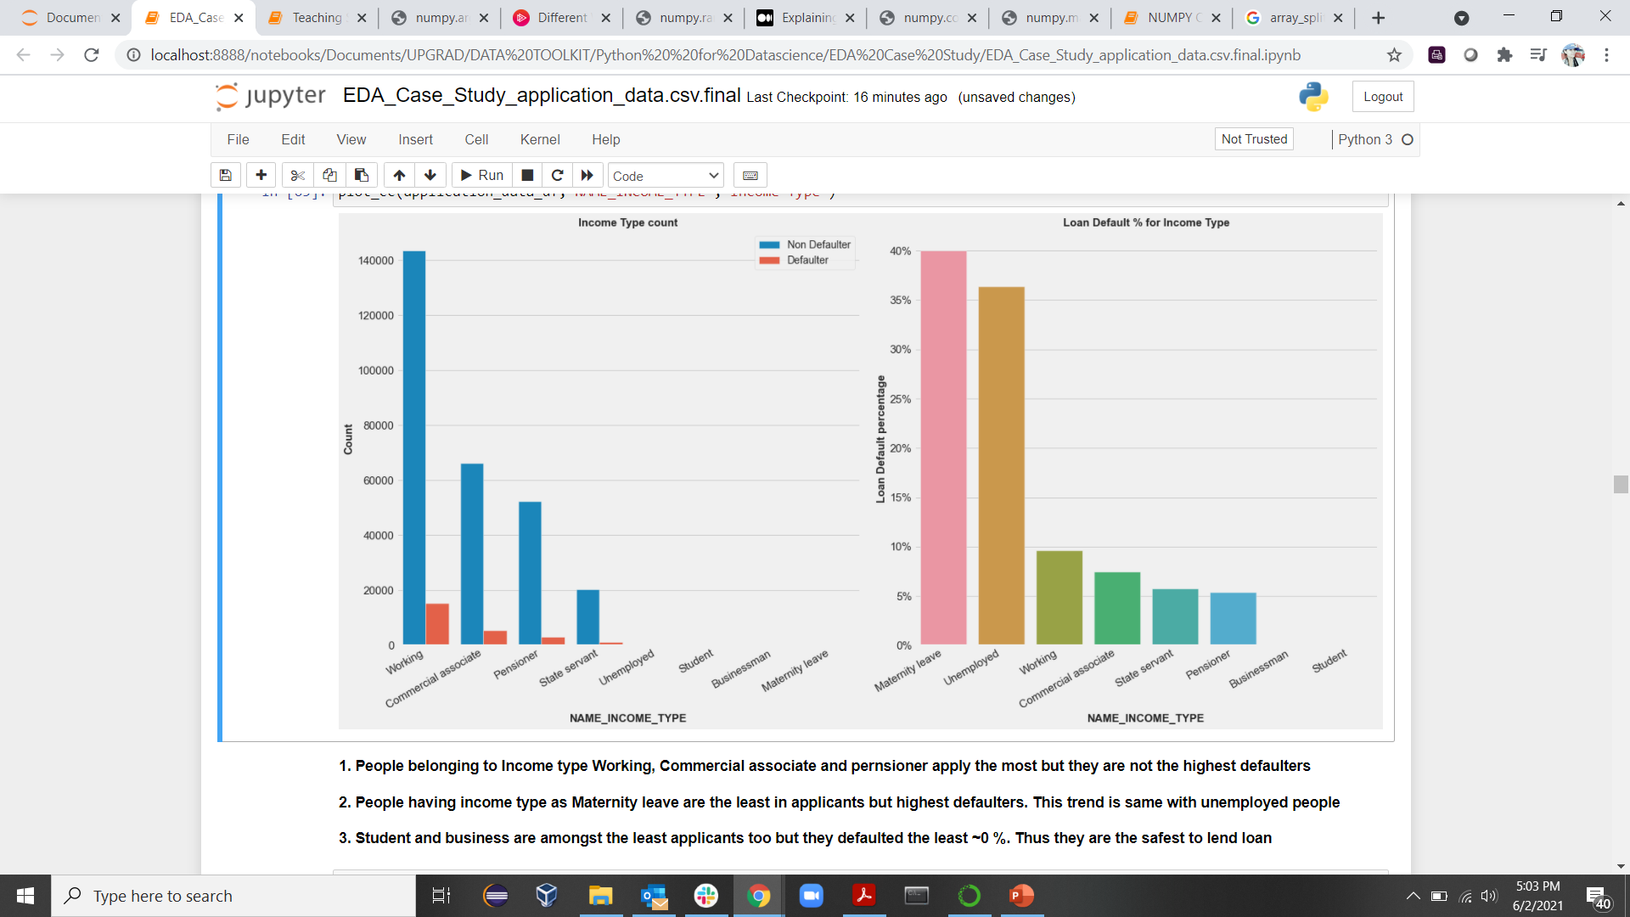
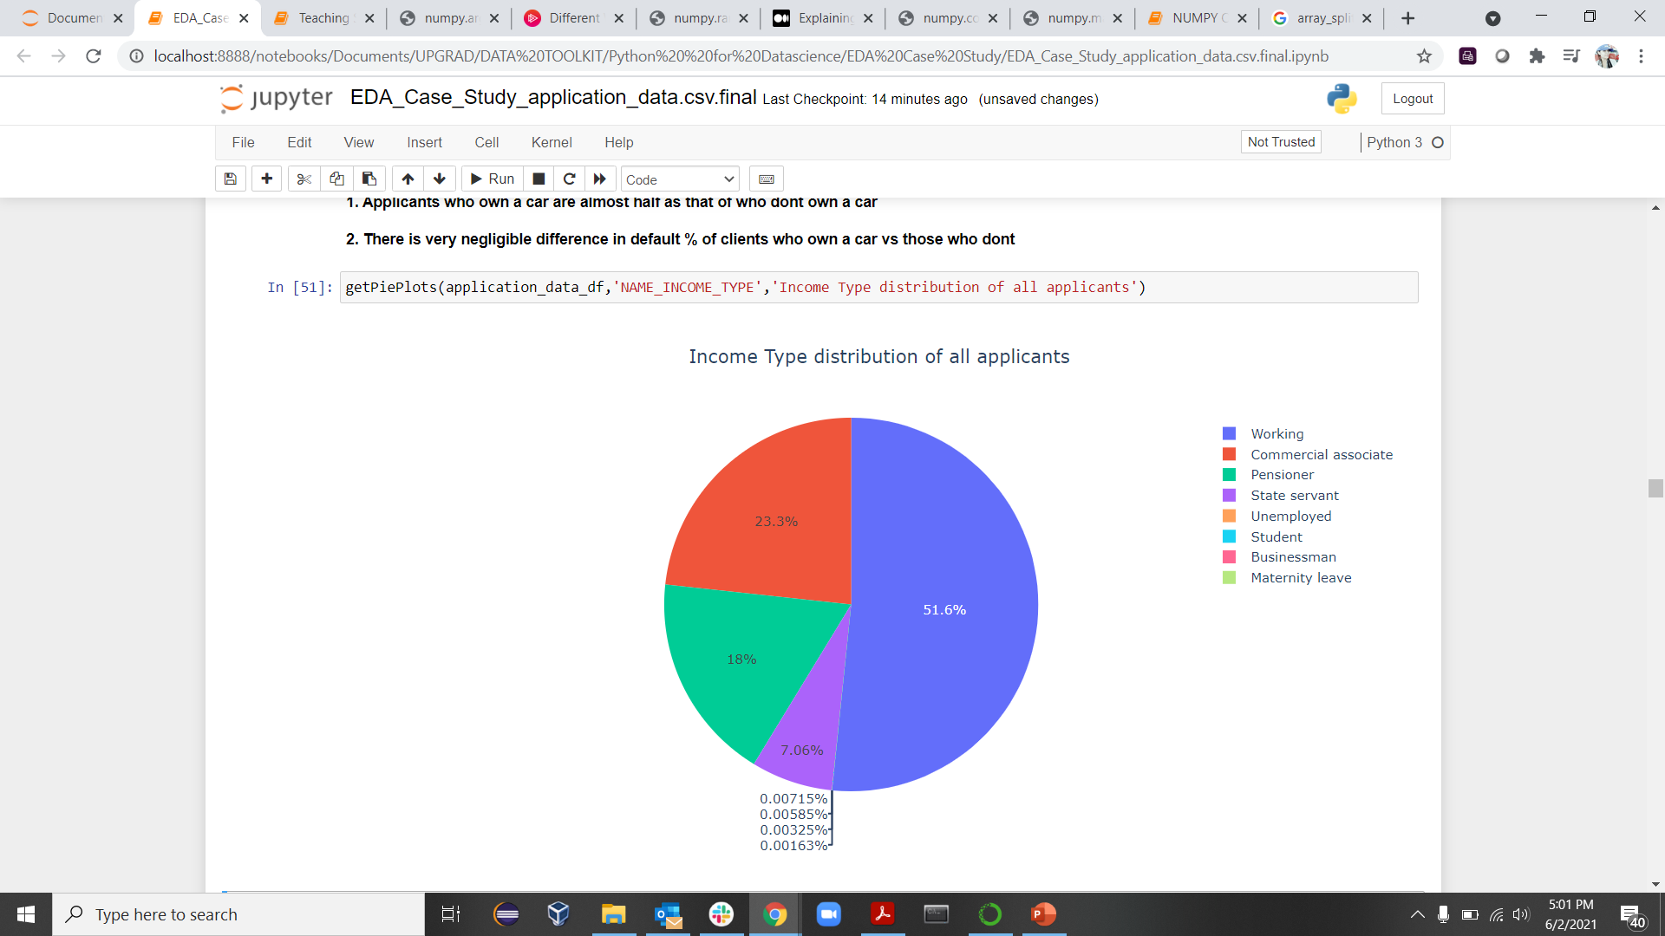
Name_Income_Type

Slide 15
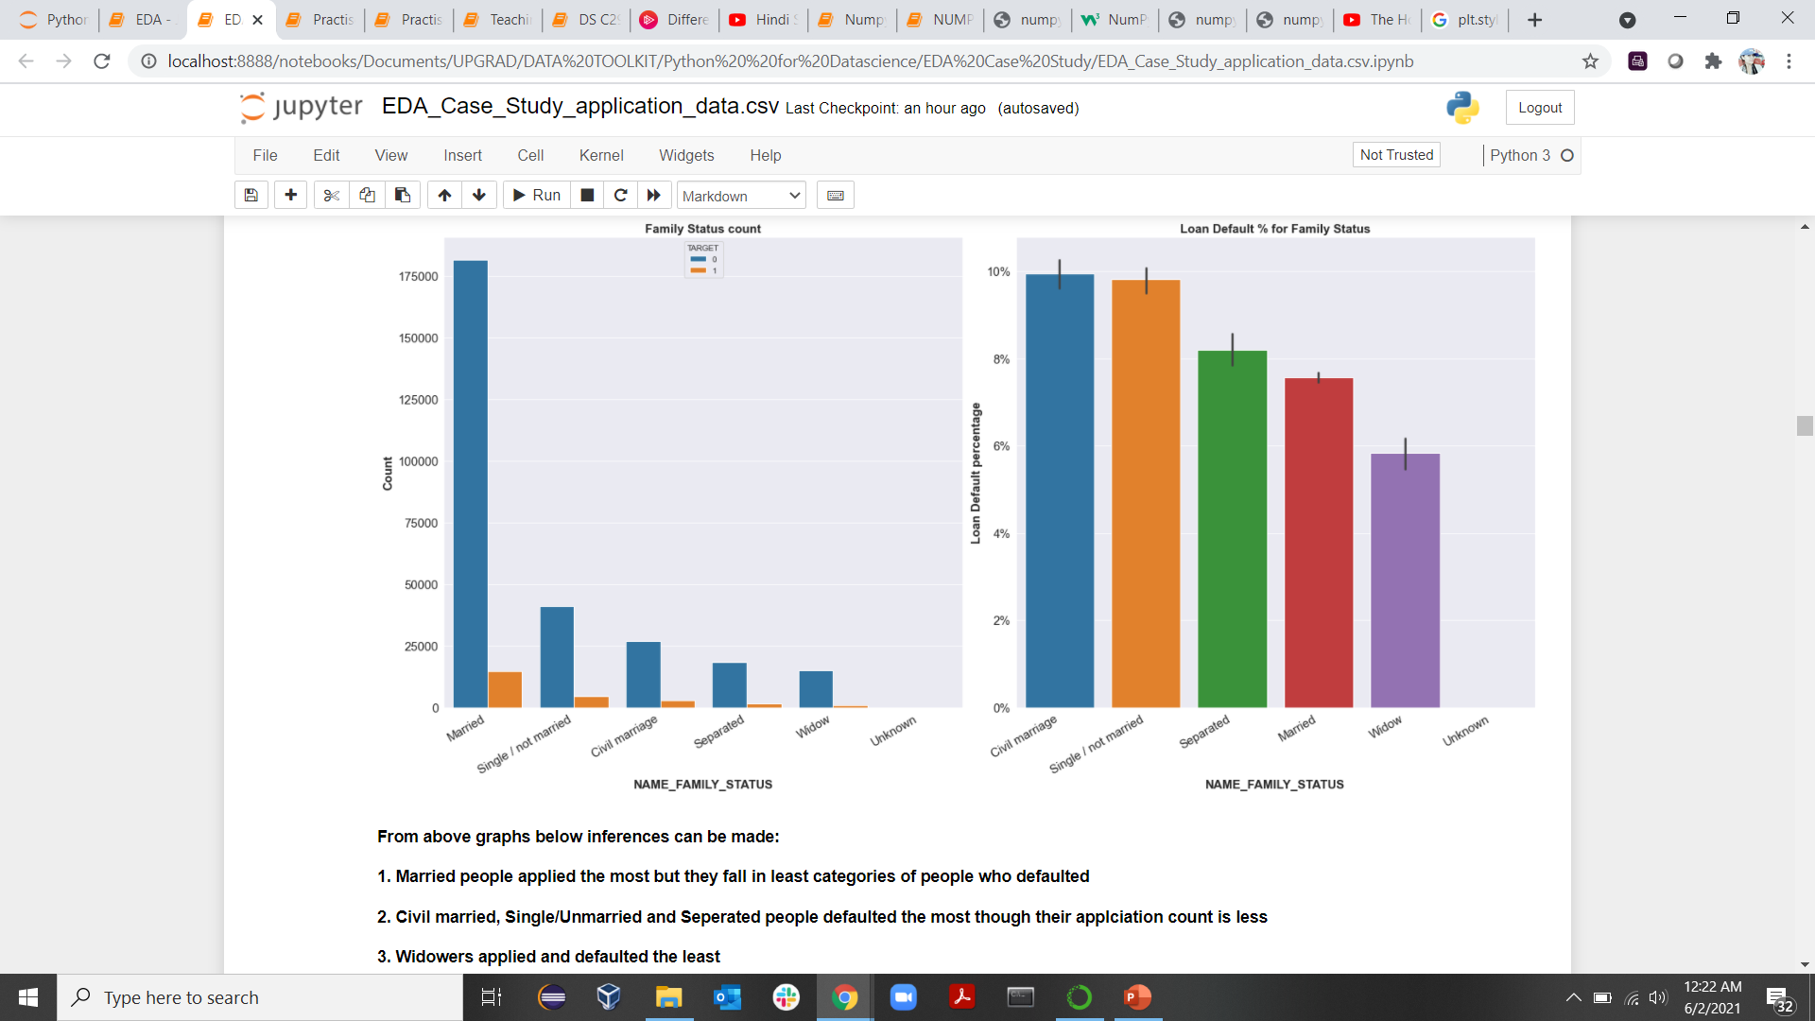
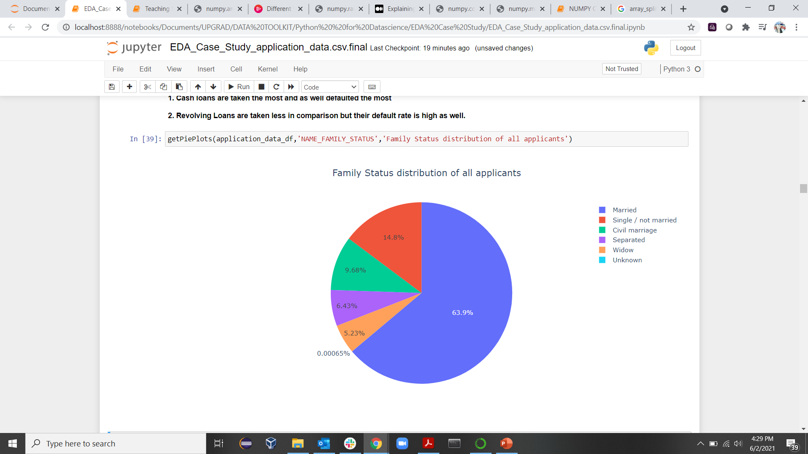
Name_Family_Status
From above graphs below inferences can be made:
1. Married applicants applied the most but they fall in least categories of people who defaulted
2. Civil married, Single/Unmarried and Separated applicants defaulted the most though their application count is less
3. Widow applicants applied and defaulted the least

Slide 16
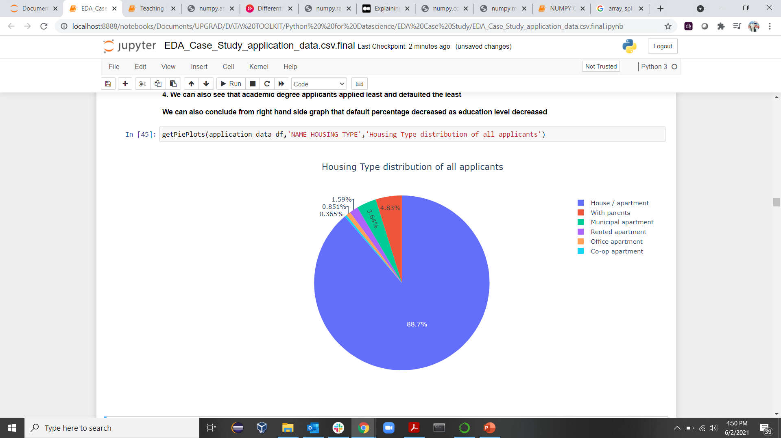
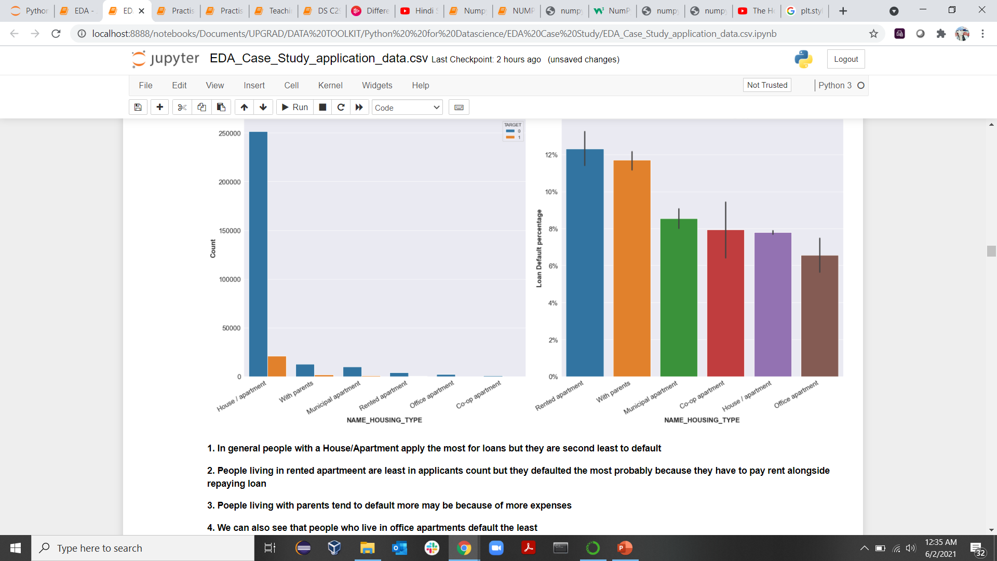
Name_Housing_Type

Slide 17
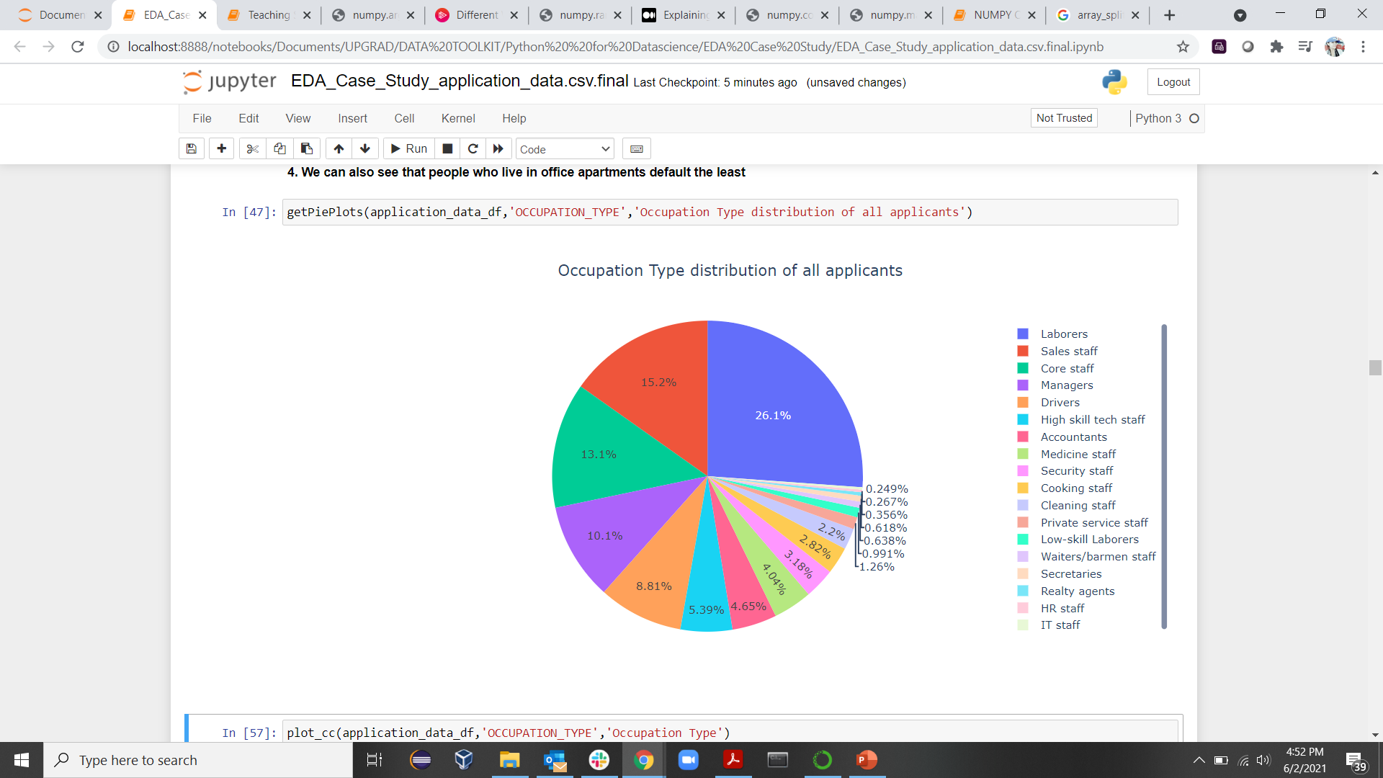
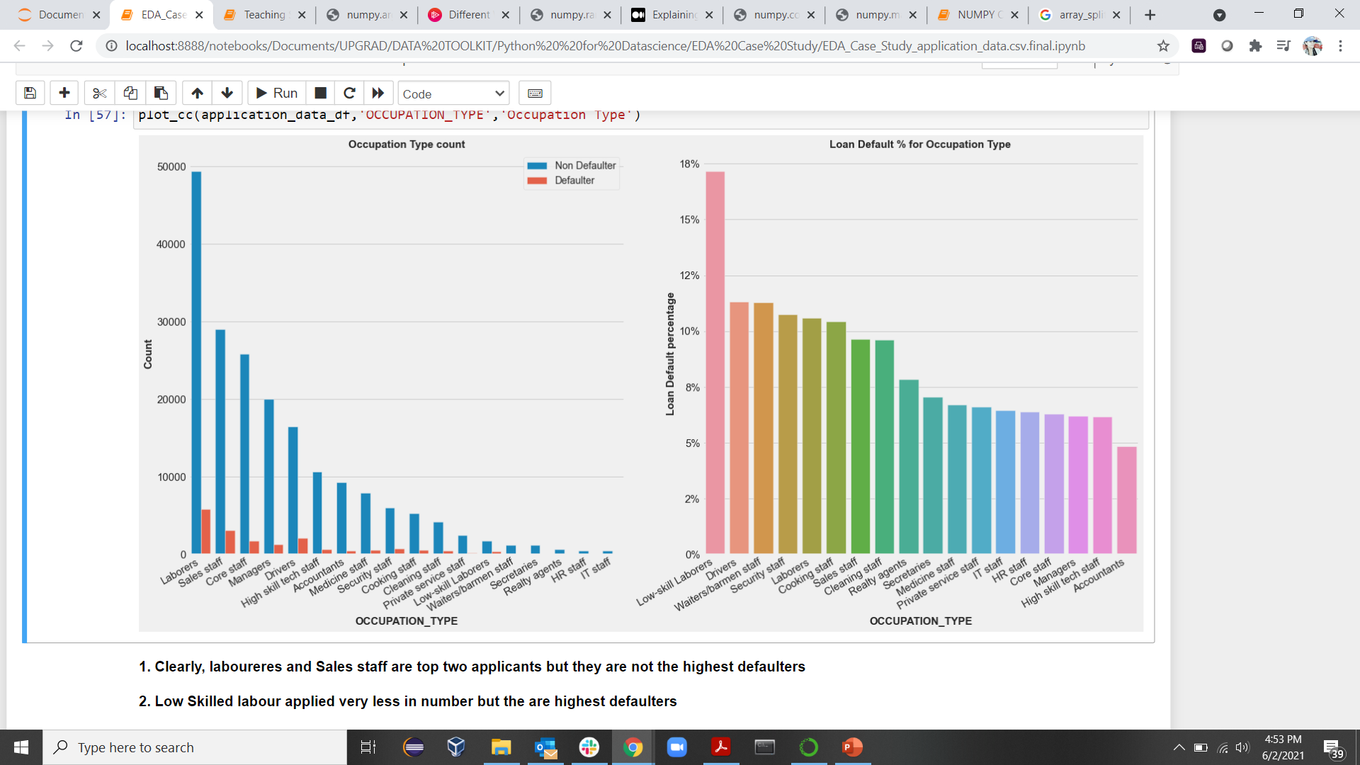
Occupation_type
OCCUPATION TYPE

Slide 18
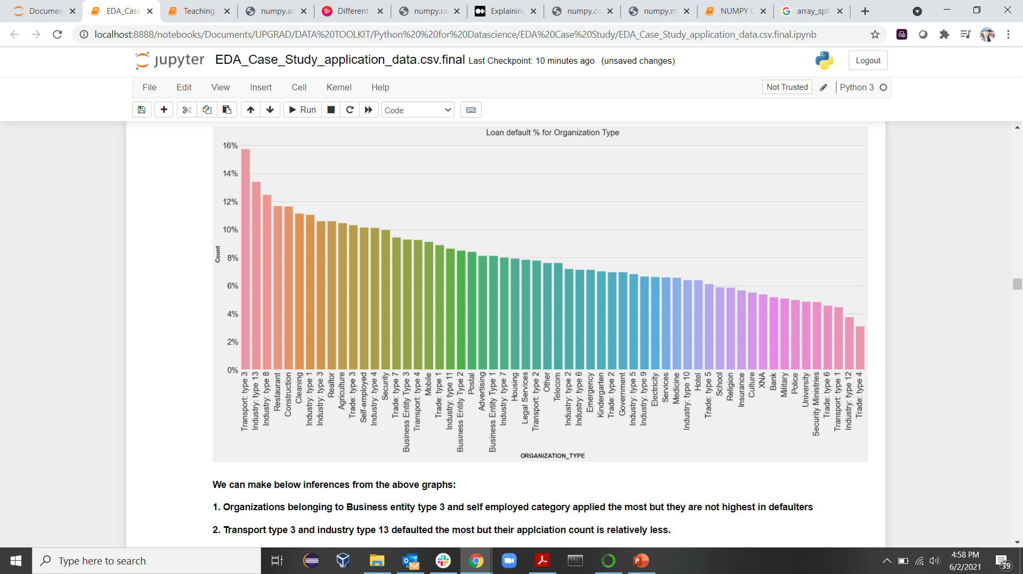
Organization_Type

Slide 19
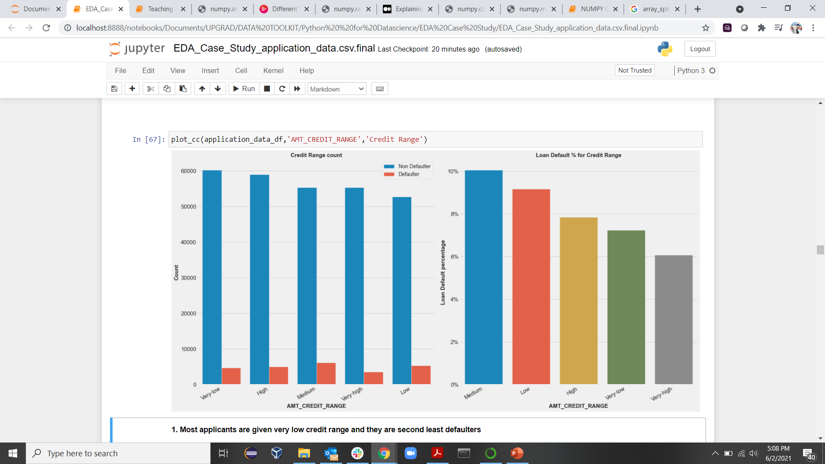
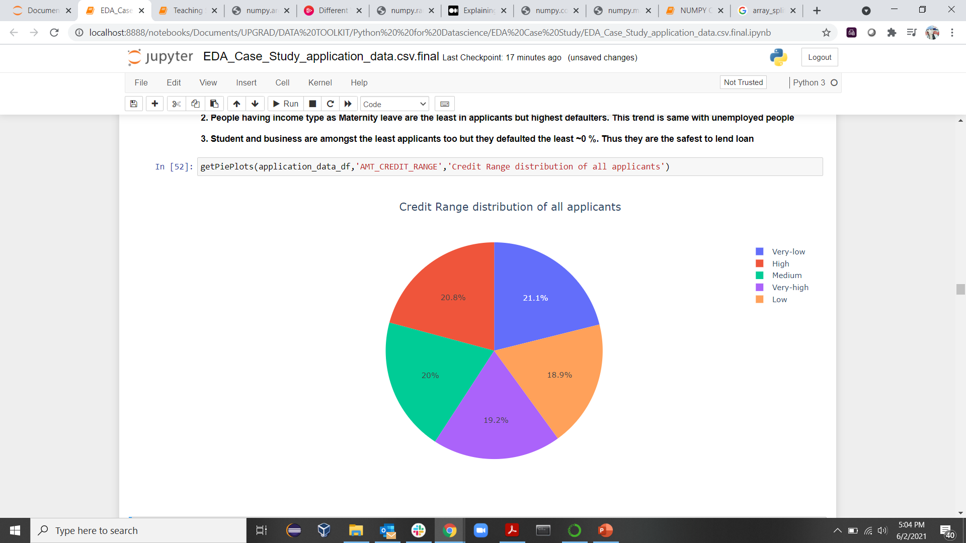
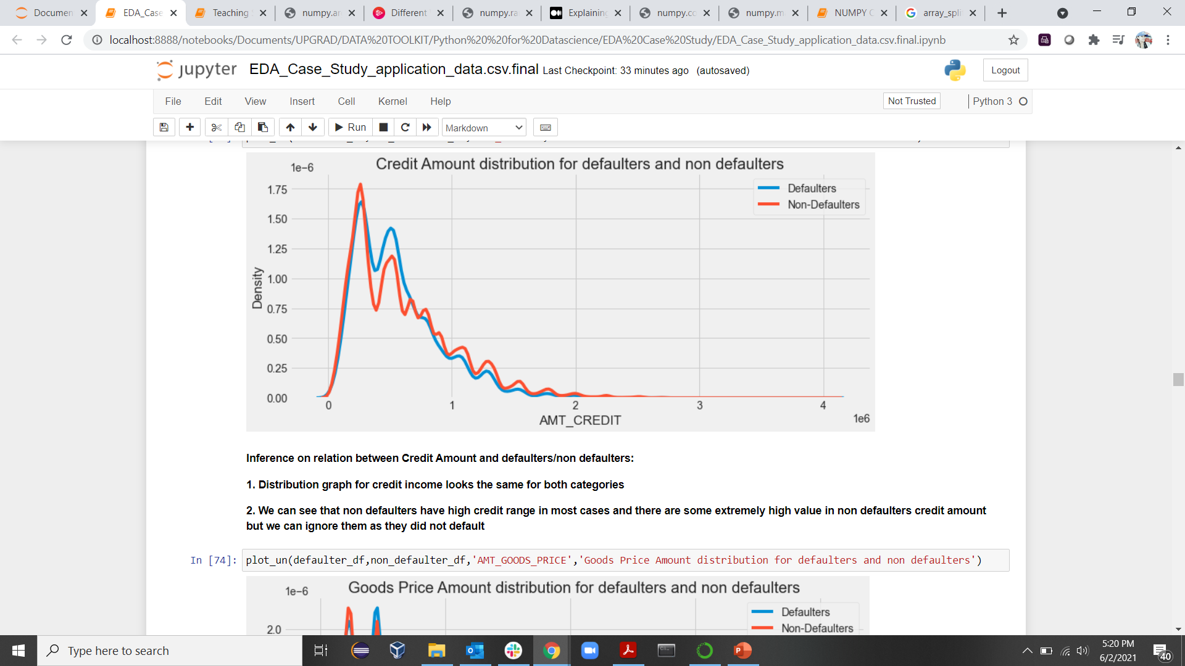
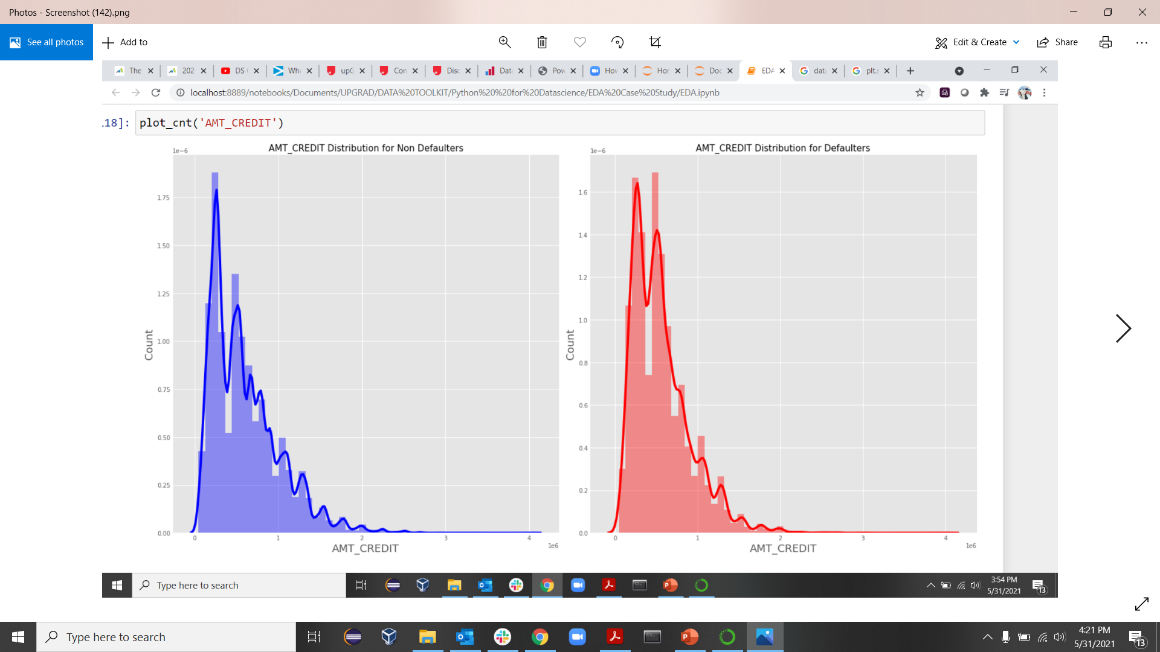
Amount Credit
1. Most applicants are given very low credit range and they are second least defaulters
2. Very High credit range is given the least only next to low credit range but people with very high credit range defaulted the least
3. Medium and Low credit ranged defaulted the most
In conclusion very high and very low defaulted the least followed by high credit range so, people given higher credit ranges default the less

Slide 20
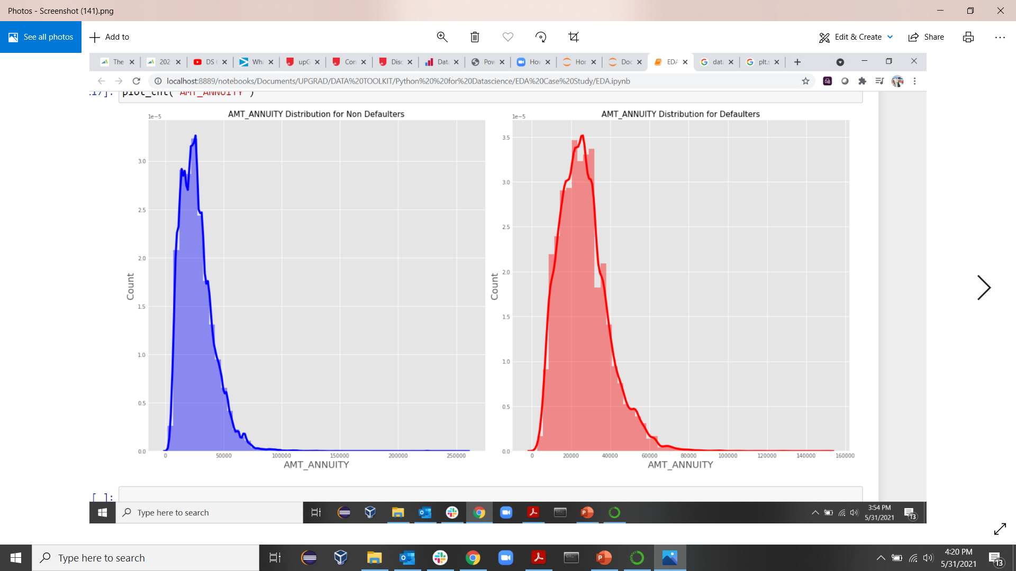
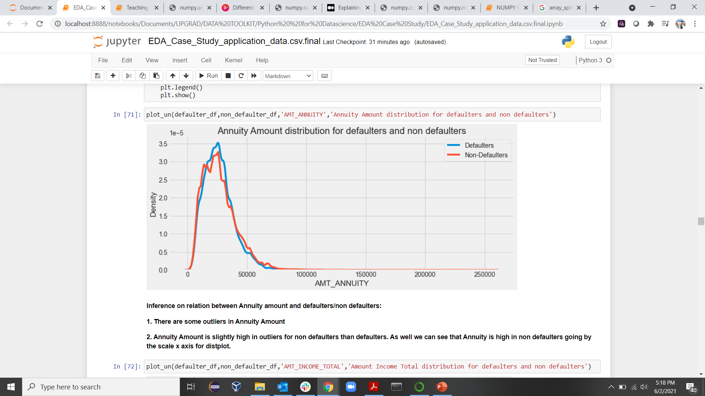
Amount Annuity

Slide 21
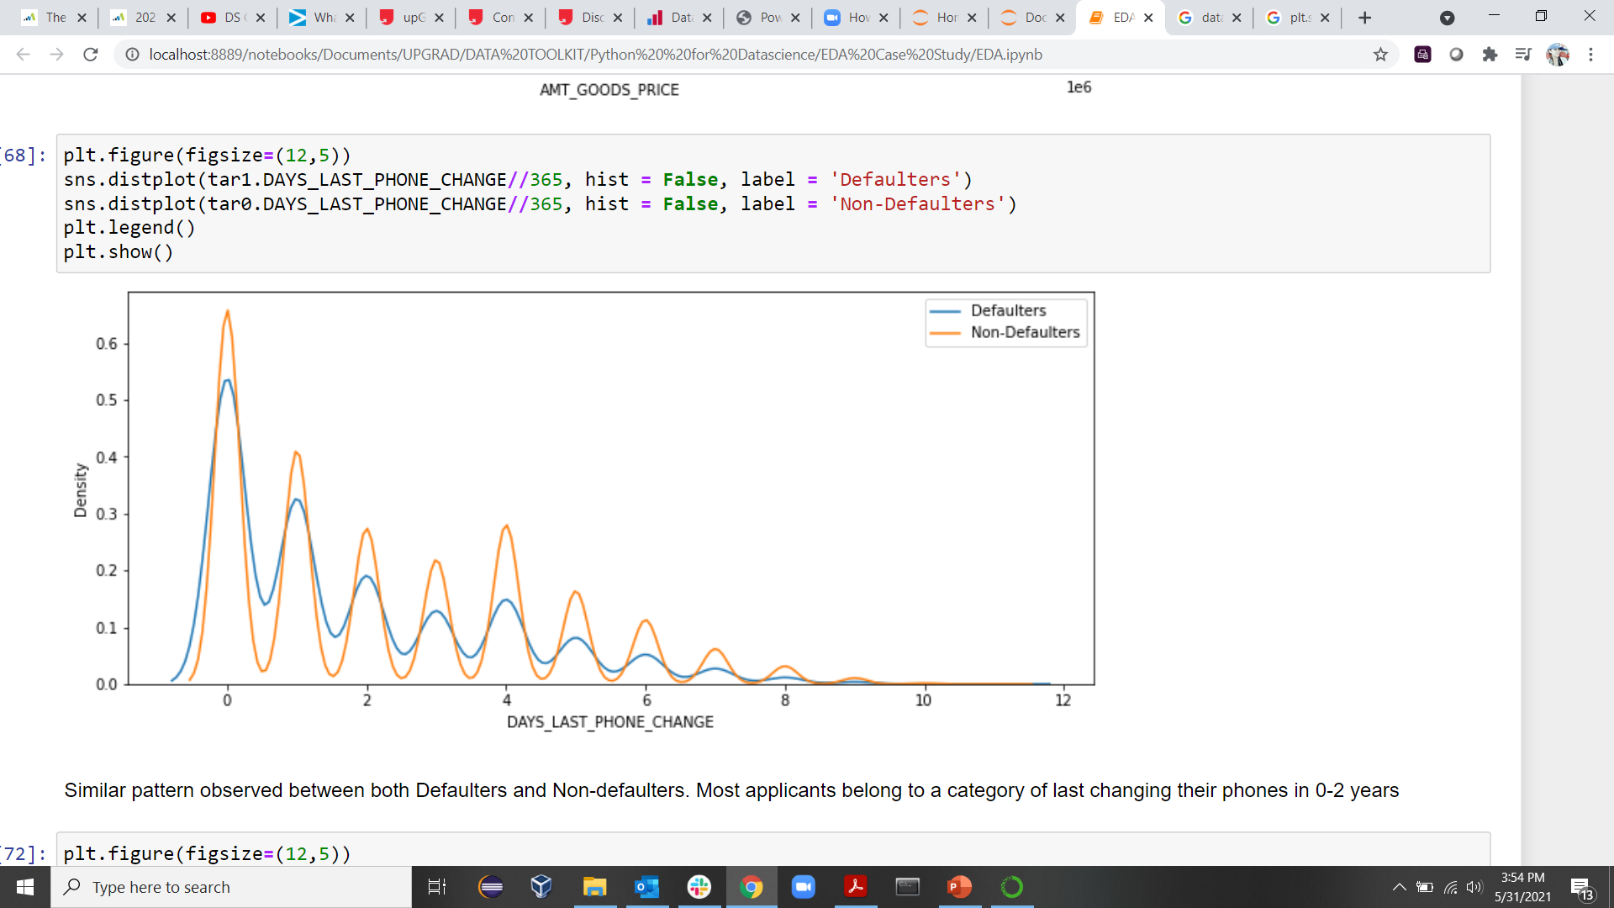
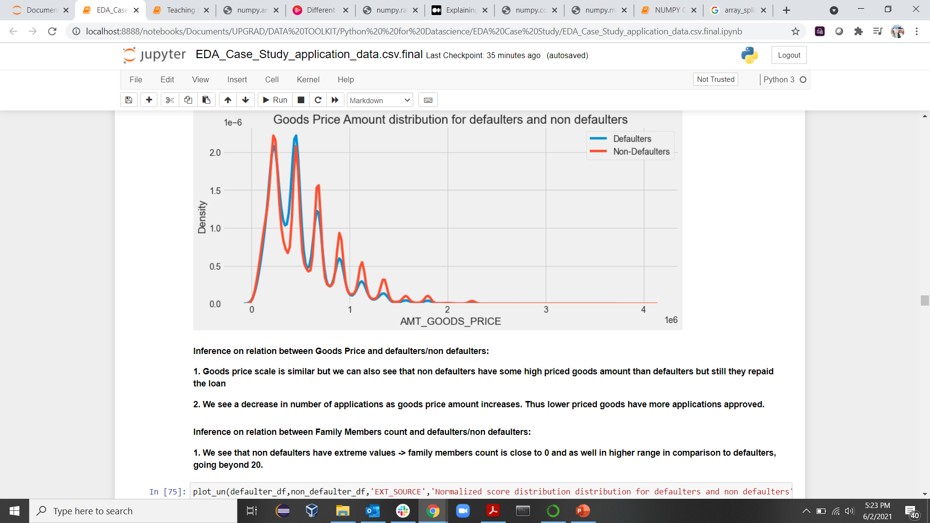
Days Last Phone Change
AMT_GOODSPRICE

Slide 22







Univariate Analysis Conclusion - drivers for loan defaulters :
1. AGE: Very young people and young people default the most as compared to other age groups.
2. GENDER: Female applicants are higher in number however male applicants defaulted more.
3. OCCUPATION: Low skill Labourers and drivers default the most.
4. WORK EXPERIENCE: Applicants with lower experience defaulted the most.
5. Income Type: People with income type as Maternity leave and unemployed defaulted the most
6. Region Rating of the client: Clients belonging to rating 3 regions defaulted the most

Slide 23

Bivariate & Multivariate Analysis
Categorical-Categorical
Categorical-Numerical
Numerical-Numerical

Slide 24
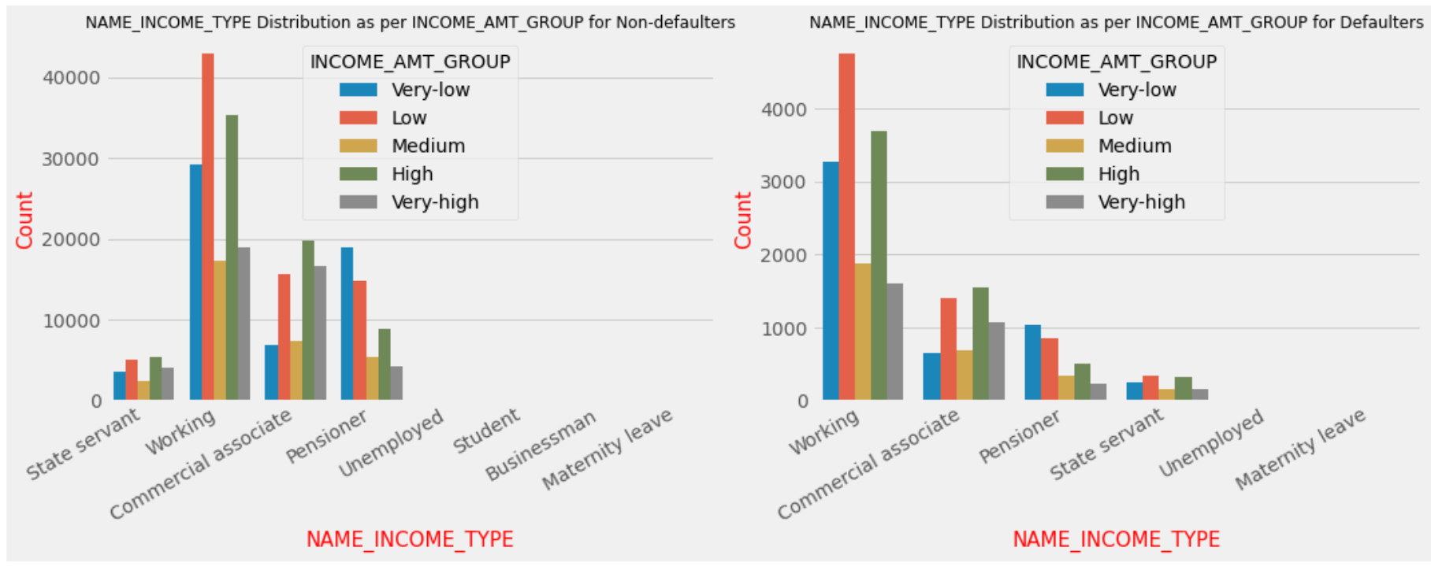
NAME_INCOME_TYPE AND INCOME_AMOUNT_GROUP
Inference :

Slide 25
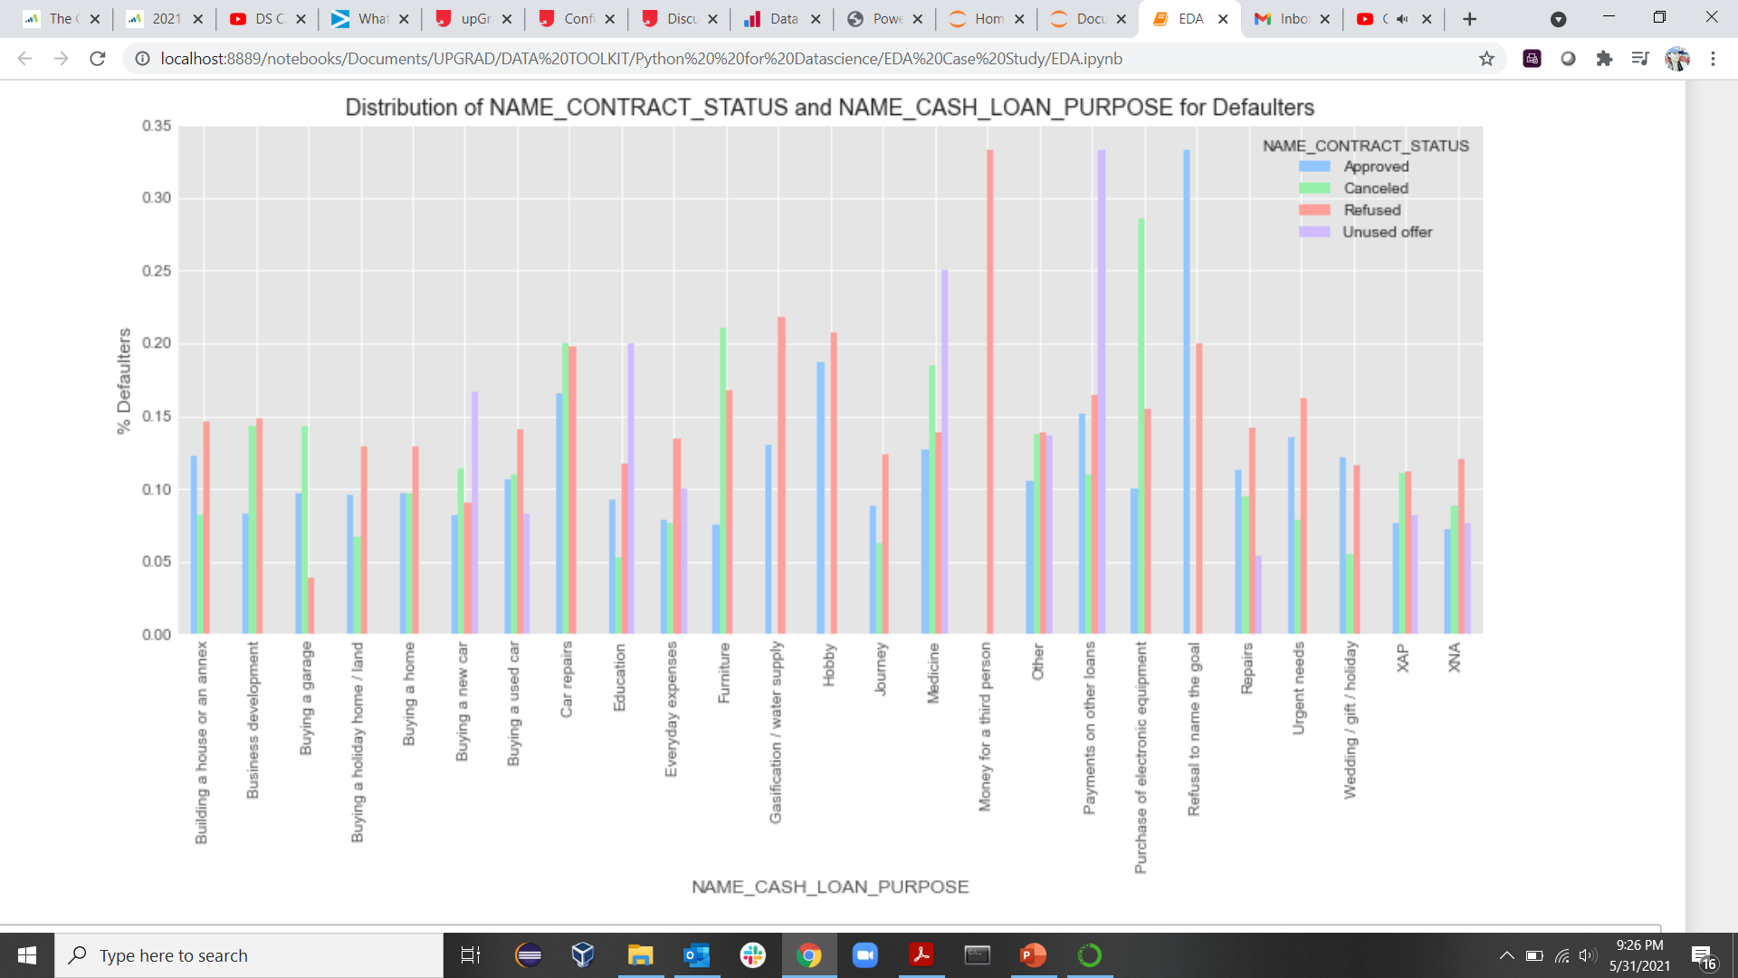
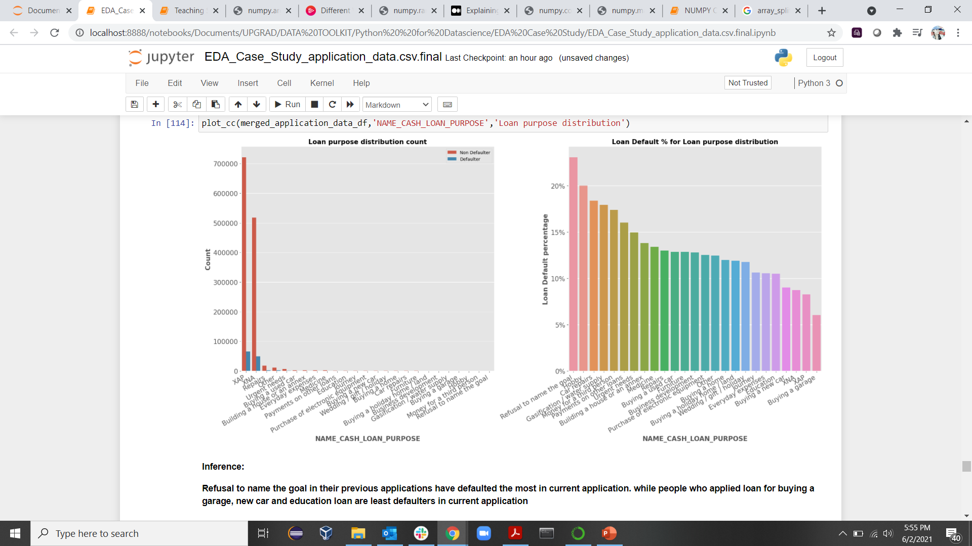
NAME_CASH_LOAN_PURPOSE

Slide 26
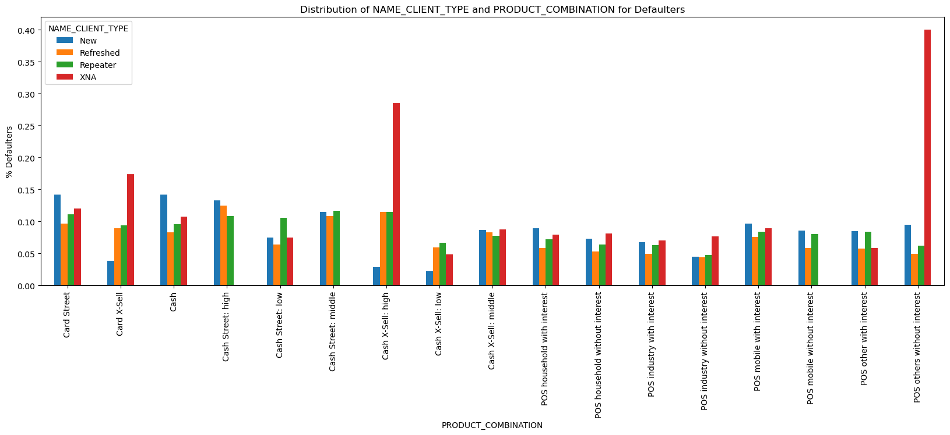
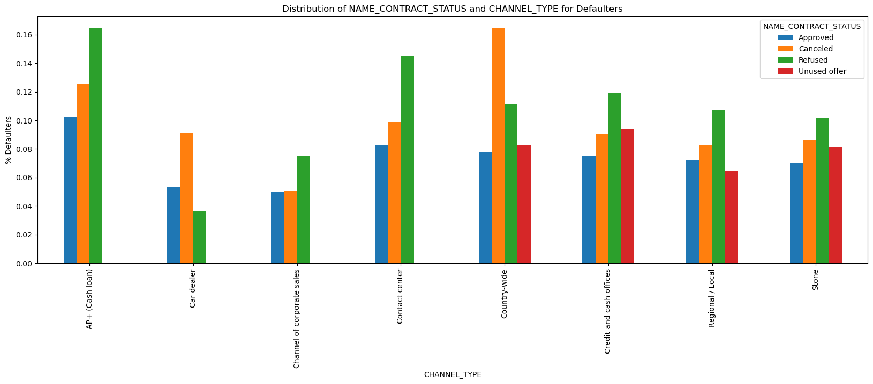
NAME_CLIENT_TYPE AND PRODUCT_COMBINATION
NAME_CONTRACT_STATUS and CHANNEL_TYPE
Inference :
New applicants with Card Street and Cash Product combinations have defaulted more as compared to others
All client types (new, refreshed and repeaters) from product combinations : Cash X-Sell: Middle and Cash Street :middle have an almost equal probablity to default
Inference :
1. Applicants with a Refused contract status and AP+(Cash loan) channel type have defaulted the most along with Cancelled contract status and Country-wide channel type
2. In general, applicants with refused status type have defaulted the most
3. Applicants with Channel Type : Car dealer and Corporate sales have defaulted less as compared to others

Slide 27
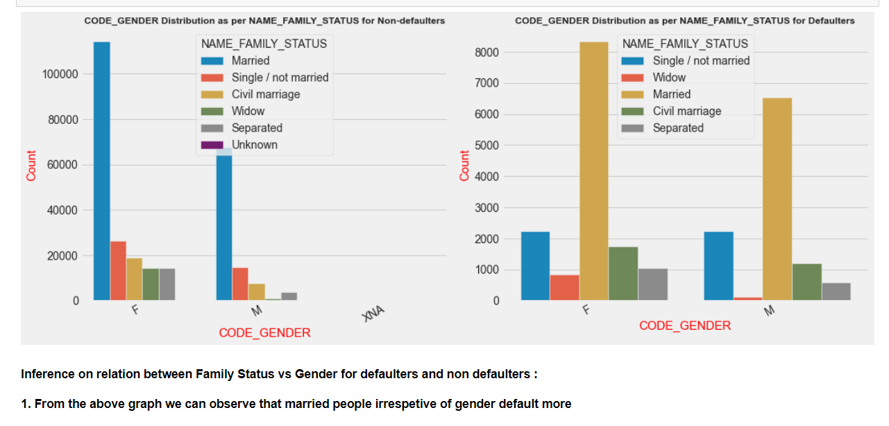
NAME_FAMILY_STATUS vs CODE_GENDER

Slide 28
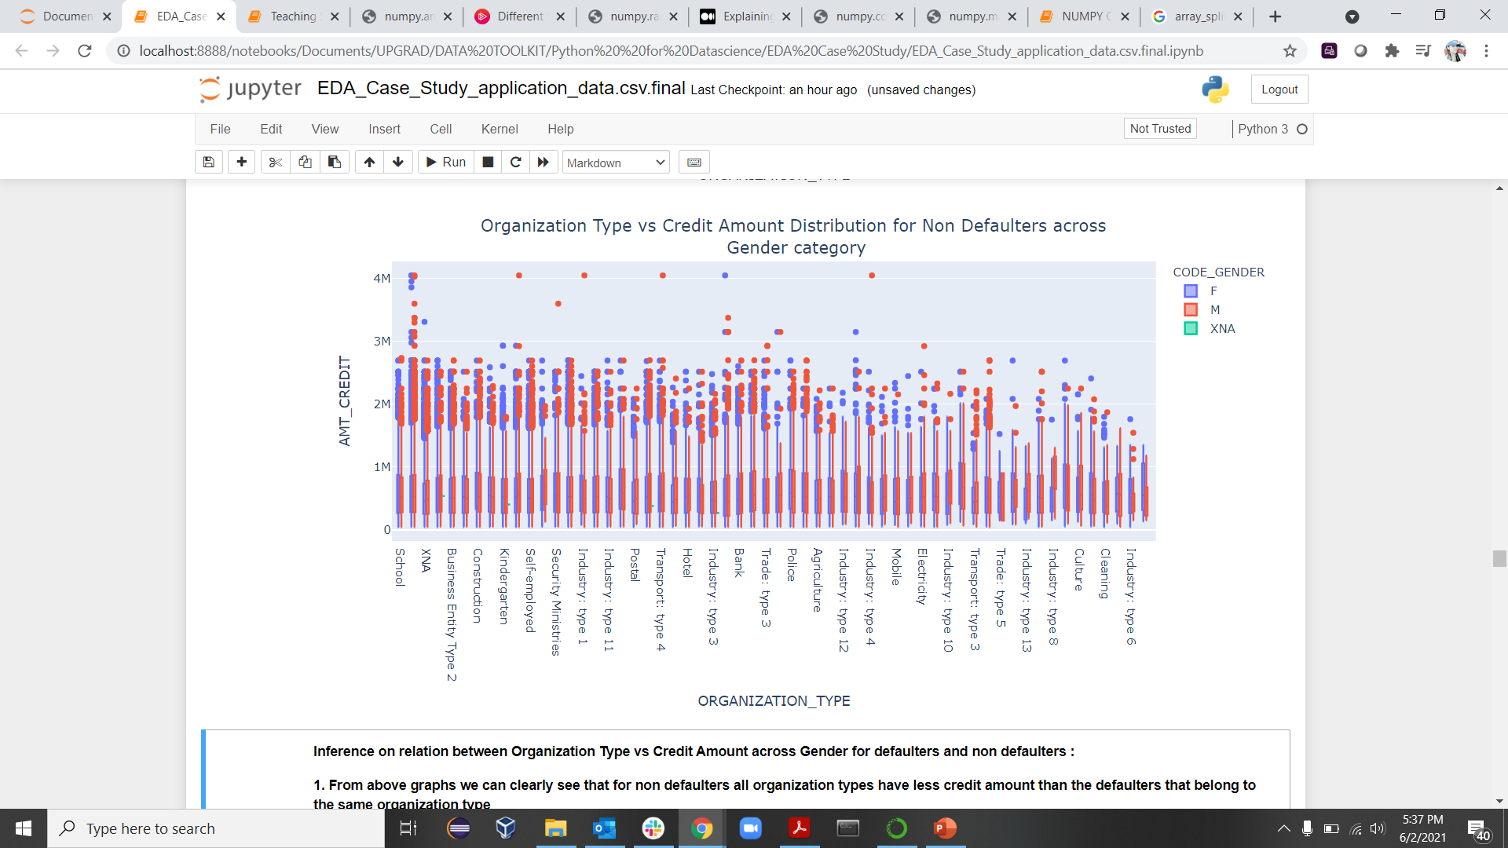
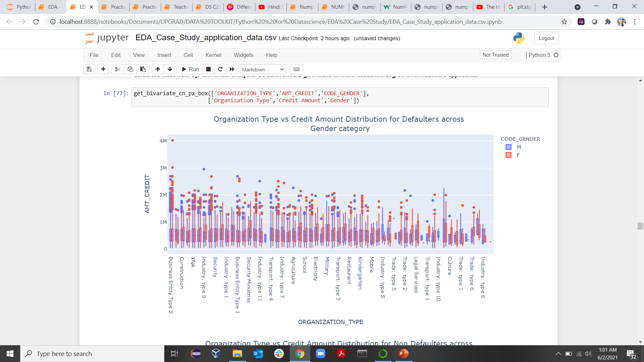
ORG_TYPE, GENDER AND AMT_CREDIT
From below graph we can clearly see that for non defaulters all organization types have less credit amount than the defaulters that belong to the same organization type
Business Type 3 defaulted the most and it is evenly spread across genders

Slide 29
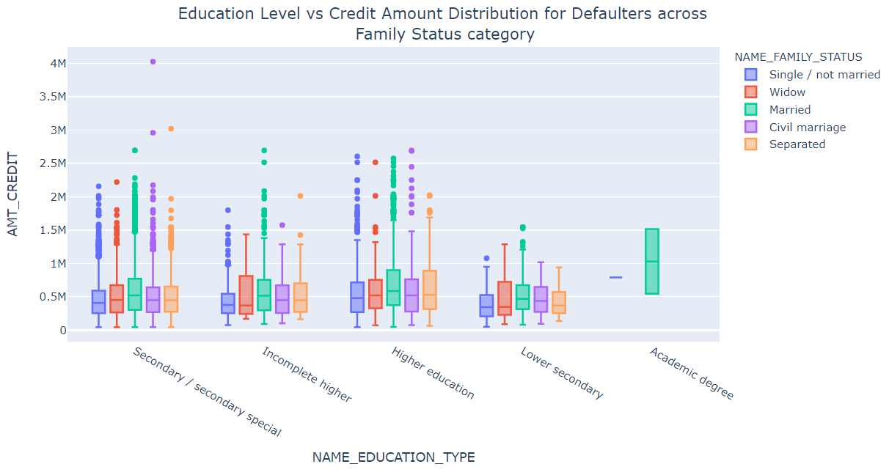
NAME_EDUCATION_TYPE, FAMILY_STATUS AND AMT_CREDIT
Inference on relation between Education Level vs Credit Amount for defaulters and non defaulters across varous Family Status Category :
1. We can see that credit amount is higher on the whole or has most outliers mainly in higher educated and Secondary/secondary educated people in both defaulters and non defaulters
2. From our univariate analysis of education levels we saw that lower Secondary educated people defaulted most and they have lowest amount credited
3.Married, civil marriage and separated family status with academic degree got most credit amount than other family status and education combination
4. In general, people having academic degree have a higher starting range of amount credited and they have very less presence in defaulters.

Slide 30
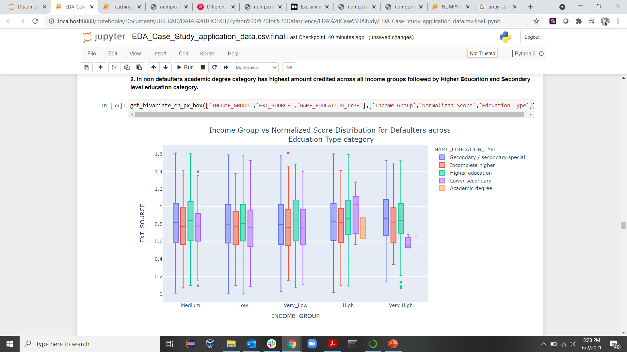

INCOME-GROUP, EDUCATION-TYPE AND EXT-SOURCE
Inference on relation between Education Level vs Ext Source for defaulters and non defaulters :
Irrespective of education type non defaulters have more EXT SCORE which clearly starts above 0.85 and ends closer to >=1.25 for non defaulters where as EXT SCORE starts near 0.6 for defaulters and ends near 1.1 at max.
Also, Higher Eucation and Academic Degrees have higher EXT scores and we have seen in our univariate analysis that people with higher EXT score default less.
Also observe that in defaulters academic degree educated people are present in only high and very high income group and these income groups defaulted least from our univariate analysis.
So bank should give loans to more academic degree level educated applicants.

Slide 31

NAME_EDUCATION_TYPE, FAMILY_STATUS AND AMT_INCOME_TOTAL

Slide 32


INCOME-TYPE vs INCOME-TOTAL
Inference on relation between Income Type vs Income Total for defaulters and non defaulters :
1.In defaulters we see that maternity and unemployed income types earn the least. And we have seen that they defaulted the most in univariate analysis
2. Businessman earns the highest and we saw that that they defaulted least only next to students in our univariate analysis. So banks should consider giving loans more to businessman income type

Slide 33

Multivariate Analysis (numeric variables)
Inferences:
Correlating factors amongst the loan applicants :
Credit amount is highly correlated with amount of goods price loan annuity total income.
Also, the applicants have high correlation in number of days employed.

Slide 34

Pair Plot
Inference on relation between various numerical variables in non defaulters dataframe :
1. Credited Amount, Annuity amount and Goods price amount are pairwise linearly proportional to each other
2. We also see that EXT Score is high in non defaulters by its distribution which is skewed to right
3. AMT_INCOME_TOTAL does not have very strong relation with others. It maintains a uniform pattern.

Slide 35





Bivariate Analysis Conclusion -Top drivers for loan defaulters
1. Education Level - Income group :
i. Well educated people draw higher incomes and defaulted less.
ii. Lower educated people draw less salaries and they defaulted more
2. Business Entity Type 3 - Credit Amount: Organizations that belong to Business Entity Type 3 category have highest credit amount and they defaulted the most
3. Apartment - Car Ownership: Organizations that belong to Business Entity Type 3 category have highest credit amount and they defaulted the most
4. Income type and income amount : Clients of Maternity leave applied least but defaulted the most because their income level is low which is the same case with Unemployed income type. So the bank needs to carefully check the income associated with income type before lending loan
5. Family Members - Credit Amount : Families having high members count but given low credit amount tend to default less than less family members and more credit amount

Slide 36

CONCLUSION
Current Application Data insights:
There has been a case where a 20 member family client did not default as credit amount was low. This can be considered as a positive aspect to strategize reaching out clients with more or less family members with less credit amount or more interest rate in the latter case
Previous clients data insights:
1. 91% of previously cancelled clients have repaid in current application
2. 88% of refused clients have also repaid in the current application
3. 92% of clients who has unused the offer have taken and repaid it n current application
Based on these we can conclude that bank should not forgot previously cancelled , refused or unused offer clients and look into the details and provide loans to the maximum possible extent in order not to lose client and business.

Slide 37

THANK YOU
THANK YOU

